Slide 1
TRANSCRIPTION FACTORS
Natàlia Morante, Aina Maria Nicolau, Marta Vila

Slide 2
Introduction
Molecular recognition = exact fit between the surfaces of 2 molecules
TFs
TRANSCRIPTION FACTOR
Key cellular components
GENE
ATCGTACT
Gene expression
BINDING SITE
PROTEIN

Slide 3
Introduction
A typical TF has multiple functional domains:
  DNA binding domain: necessary to recognize and bind to the DNA strand.
  Trans-activating domain: interacts with other proteins.
  Signal sensing domain: transmits an external signal to the rest of the complex.
Most common classification based on their DNA binding structural motifs

Slide 4
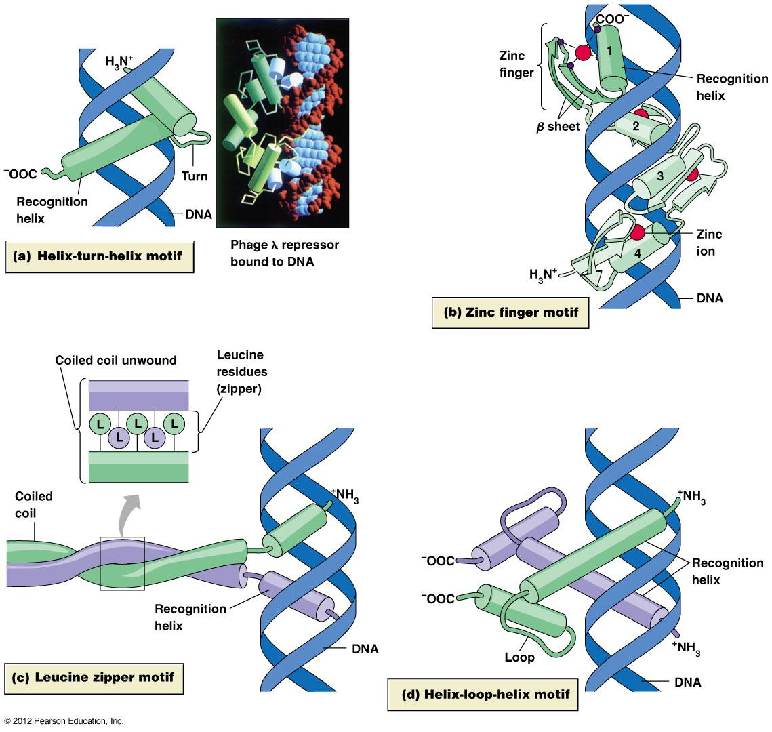
Classification DNA binding motifs
Principles of Cell Biology Brian E. Staveley's.
Notes:
The most common classification of TFs is based on the structure of their DNA-binding domains and includes the following motifs:
Basic helix turn-helix
Helix –loop- helix
Zinf Finger
Basic leucine zipper

Slide 5
Objectives
Description of the 4 main DNA-binding motifs.
Search for conserved residues in same family.
Molecular description of TF-DNA binding.

Slide 6
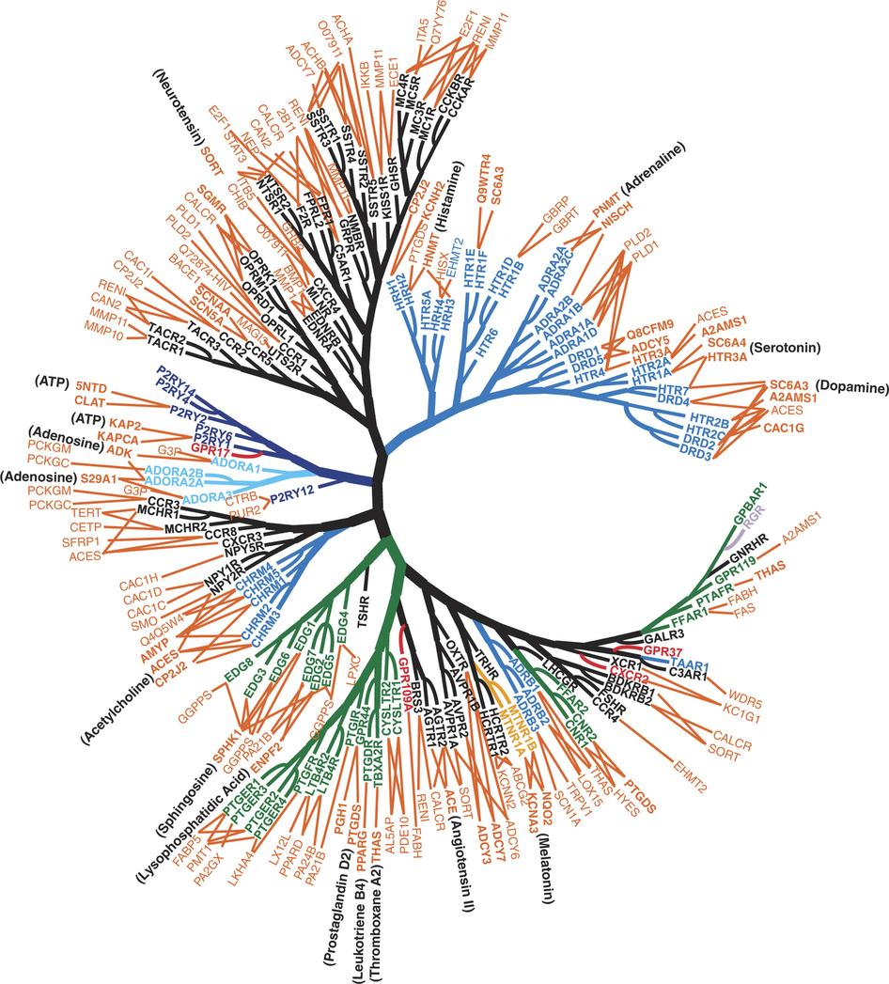
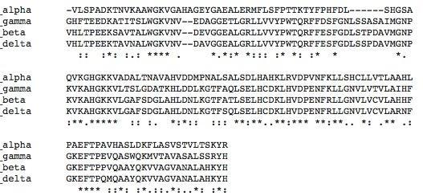
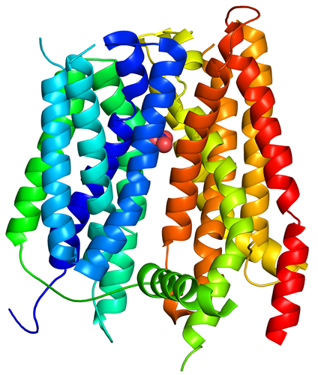
Methodology
Families
  Pfam
Sequence
  PDB
Structure
  PDB
  SCOP
Notes:
We selected 1 transcription factor of each DNA binding domain, that we used as an example.
Then we made a homology search in P-FAM, in order to find a Hidden Markov Model for our proteins.
Then, we searched PDB with that HMM, in other to find other proteins similar to our examples, to use as templates for making alignments.
We made a mutiple sequence alignment for each DNA binding domain, and a structural alignment.
Finally, we also obtained the superimposition of the examples and the templates.
Searched DISPLAR for a prediction of DNA binding residues.

Slide 7
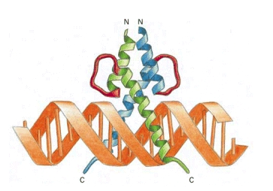
Helix-loop-helix
Consists of 2 α-helices separated by a loop.
Found in eukaryotes (from yeast to humans)
Types:
  b/HLH → conserved basic region in N-terminal.
  sometimes b/HLH/Z → contain a leucine zipper in C-terminal.
Forms dimers
Recognizes E-box:
  CANNTG
Alberts B, Johnson A, Lewis J, et al. Molecular Biology of the Cell. 4th ed. New York: Garland Science; 2002.

Slide 8
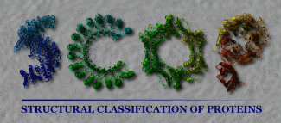
SCOP classification
Class | All alpha proteins
Fold | HLH-like 4-helices; bundle, closed, left-handed twist; 2 crossover connections
Superfamily | HLH, helix-loop-helix DNA binding domain
Family | HLH, helix-loop-helix DNA binding domain
Notes:
The HLH domains fold into a parallel, left-handed, four helix bundle with a well-defined hydrophobic core, that lies just above the DNA

Slide 9
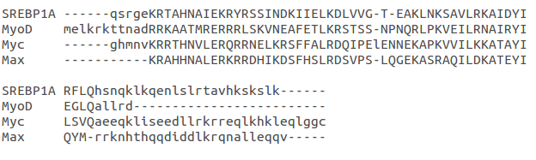
Multiple Sequence Alignment
basic region
Helix 1
Loop
Helix 2

Slide 10
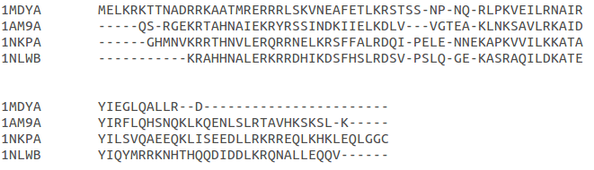
Structural Alignment
basic region
Helix 1
Loop
Helix 2

Slide 11
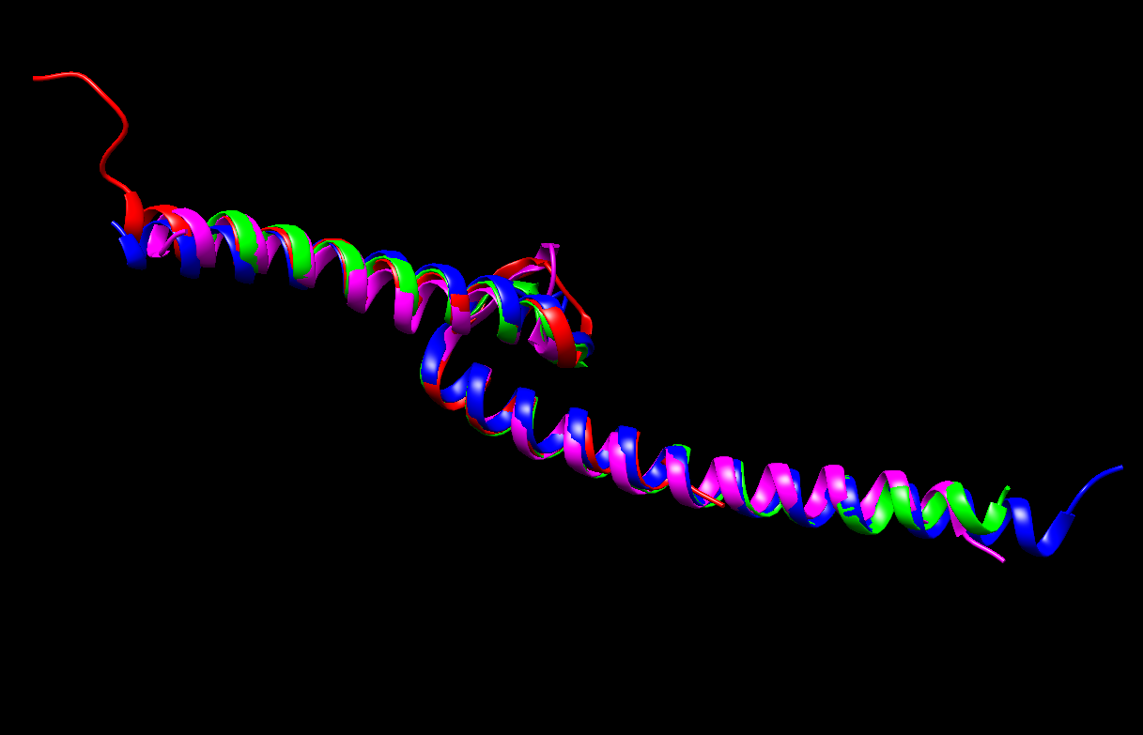
Superimposition
Sc 6.70
RMSD 0.84
MyoD (1MDY)
SREBP1A (1AM9)
Myc (1NKP)
Max (1NLW)

Slide 12
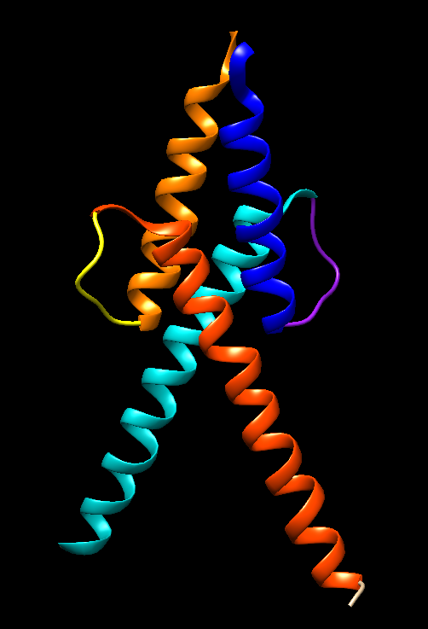
MyoD Structure
Structure:
2 long α-helices
8-residues loop
Forms homodimer

Slide 13
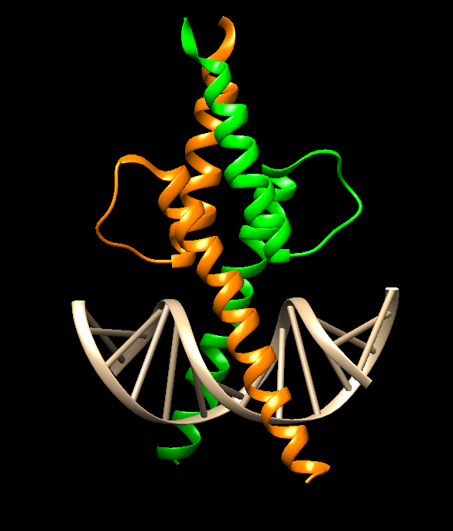
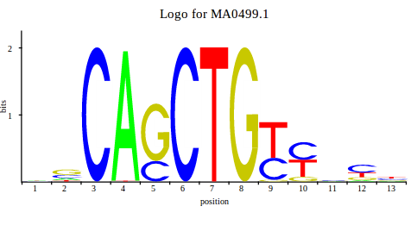
MyoD
Contacts:
Unspecific → between positively charged residues and the phosphates of the DNA backbone
Specific → with the DNA bases from the E-box (CAnnTG)

Slide 14
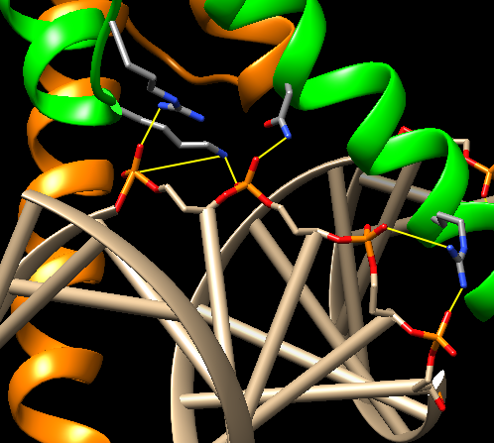
Phosphate contacts (unspecific interaction)
Arg-143
Asn-126
Lys-146
Arg-119
Notes:
Arg-119 contacts phosphates at G7’ and C8’.
Residues outside the basic region → Asn-126 (H1) contacts A6’, Arg-143 (loop) contacts C5’, Lys-146 (H2) contacts C5’ and A6’.
Total → each monomer of MyoD contacts a total of 10 positions in the DNA backbone.

Slide 15
Phosphate contacts (unspecific interaction)

Slide 16
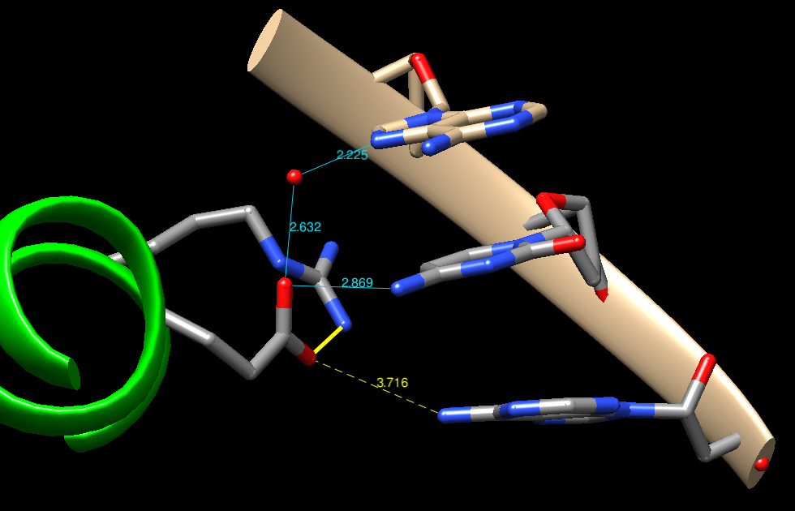
MyoD / E-box specific interaction (Glu/Arg - CA)
Arg-121
Arg-121
Glu-118
Glu-118
Notes:
H-bonds → Glu-118 and N6 Adenine (weak → too much distance) (3,716A)
Glu-118 and N4 citosin (distance → 2,869A)
Carboxylate group also makes water-mediated contact with N7 of A4.
Arg helps stabilize the conformation of Glu, which is the residue that really makes the contacts
Salt bridge → Arg-121 and Glu-118
Arg-121 contacts also with the phosphate of C5.

Slide 17
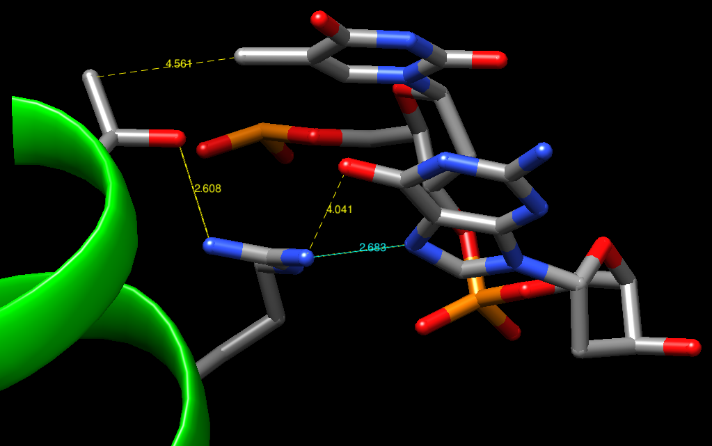
MyoD / E-box specific interaction (Arg/Thr - TG)
Thr-115
Arg-111
Notes:
Residues in the basic region also contact T and G of the bHLH binding site.
Arg-111/DNA:
H-bond to N7 of base G10’ (2,683A)
water-mediated contact to O6 of base G10’ (4.041A)
Arg-111/ Thr-115:
The Arg-111 side chain H bonds to hydroxyl group of Thr-115, (2,608A)
Unspecific contacts:
Arg-11 contacts a phosphodiester O at position G10’.(5,145A)
Thr-115 donates H-bond to a phosphodiester O at position T9’ (2,956A)
which makes hydrophobic contacts with the methyl group of T9’ (4,561). Methylene groups in Glu-118 side chain contribute to form a hydrophobic pocket in this position.

Slide 18
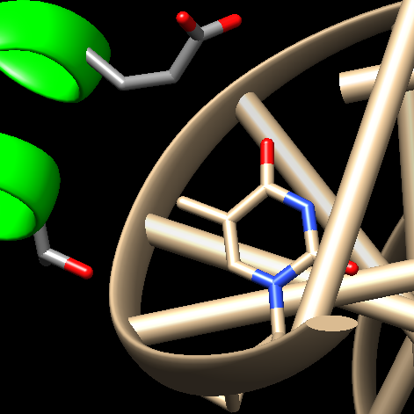
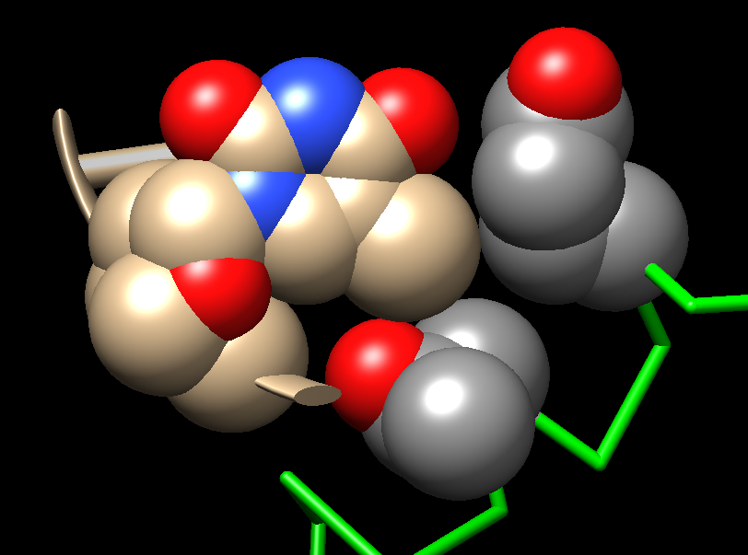
Hydrophobic pocket
Glu-118
T9’
Thr-115
Thymine (T9’)
Glu-118
Thr-115

Slide 19
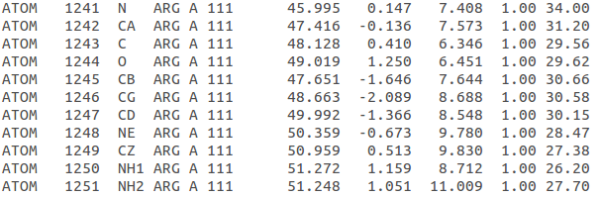
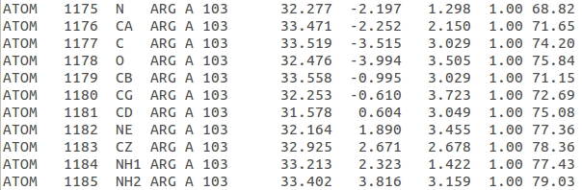
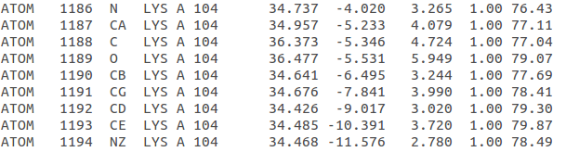
Arg stabilization (B-factor)
Thr-115
Arg-111
Notes:
measure of confidence in the location of each atom
<10: atom is not moving much, in the same place
>50: atom are moving so much. Can't be seen in the electron density map

Slide 20
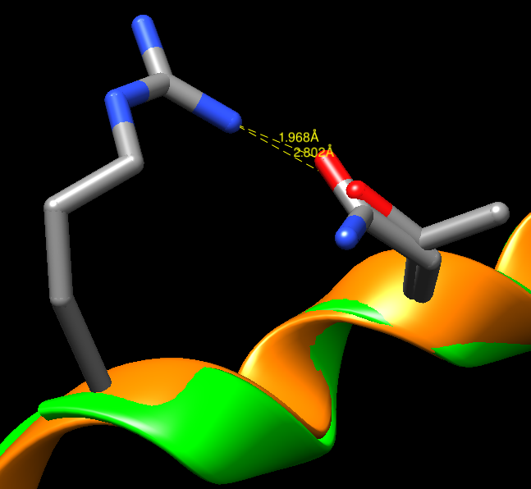
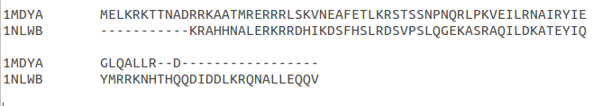
Arg stabilization
MyoD (1MDY)
Max (1NLW)
ARG
THR
ASN

Slide 21
MyoD / E-box specific interaction

Slide 22
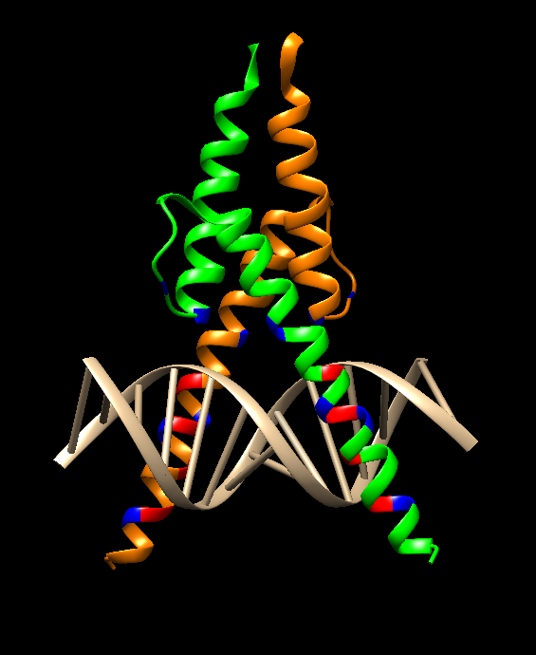
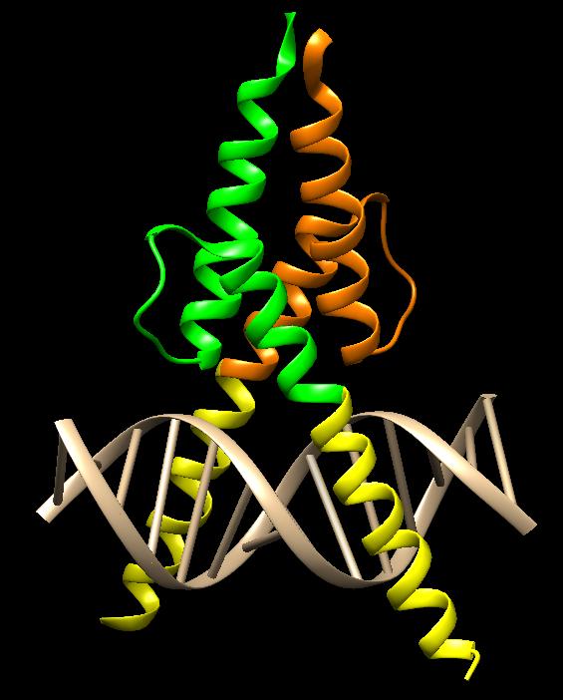
DISPLAR prediction
Contacts with bases
Phosphate contacts
DISPLAR predicted residues
Notes:
Gives many false positives

Slide 23
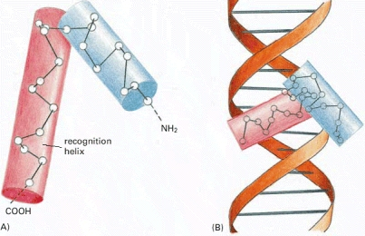
Helix-turn-helix motif
HTH motifs are found in all known DNA binding proteins that regulate gene expression.
Characterised by 2 alpha helices joined by a turn.
  Variable number of residues in the turn.
  2nd helix (recognition helix) penetrates into the major groove of the DNA.
  Amino acid side chains → important in recognising specific DNA sequence
Wide structural diversity:
  Di-helical (Homeodomain)
  Tri-helical (Myb)
  Tetra-helical (LuxR-type)
  Winged helix-turn-helix (ETS)
Alberts B, Johnson A, Lewis J, et al. Molecular Biology of the Cell. 4th ed. New York: Garland Science; 2002.
Notes:
We will describe another type of DNA binding motifs.
Helix-turn-helix (HTH) motifs are found in all known DNA binding proteins that regulate gene expression. The basic HTH motif is characterised by 2 alpha helices, which make intimate contacts with the DNA and are joined by a short turn (number of residues is variable). The second helix in the HTH motif is the ‘‘recognition’’ helix and penetrates into the major groove of the DNA target, allowing protein side-chains to make extensive base-specific hydrogen bonds and contacts.
There is a wide diversity among the HTH DNA-binding motifs with regard to their function, topology and turn conformation.
During the project we have been working on the structure of homeodomains.

Slide 24
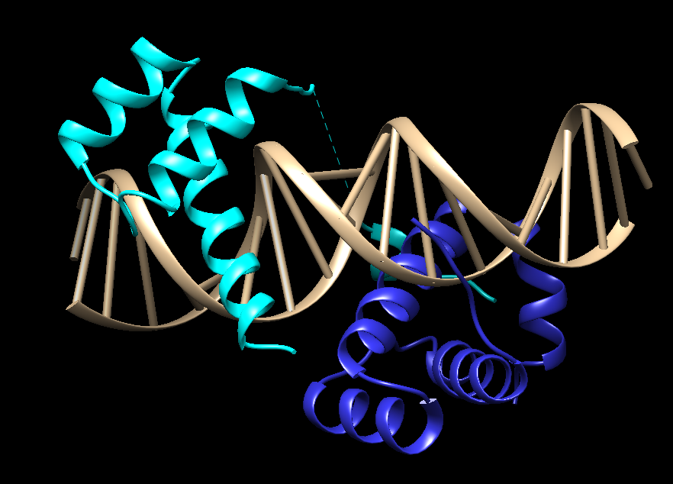
Homeodomain proteins
Comprise a large superfamily of eukaryotic DNA-binding proteins.
Regulate transcription of developmental genes.
Common features: 60 amino acid helix- turn-helix DNA binding domain.
Homeobox = DNA sequence that encodes the homeodomain → Contains Hox genes
HoxB1-Pbx1:
Pbx1 is implicated as a Hox cofactor and binds DNA cooperatively with Hox proteins.
HoxB1
Pbx1
Notes:
Members of this transcription factor family are characterized by the presence of a homeodomain, which is a 60 amino acid helix-turn-helix DNA-binding domain. The DNA sequence that encodes the homeodomain is called the "homeobox” and homeobox-containing genes are known as "hox genes." The hox gene products are homeodomain proteins that play critical roles in development, specifying patterning of the embryo.

Slide 25
SCOP classification
Class | All alpha proteins
Fold | DNA/RNA binding 3 helical bundle
Superfamily | Homeodomain-like
Family | Homeodomain

Slide 26
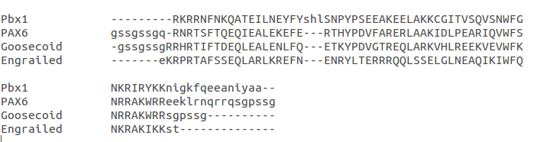
Multiple Sequence Alignment
Notes:
Engrailed homeodomain-DNA complex at 2.2 A resolution: a detailed view of the interface and comparison with other engrailed structures
residus importants per a la interacció es conserven en altres
Hipotesis → participen en dimeritzar
superponer con engrailed pq son complexes →

Slide 27
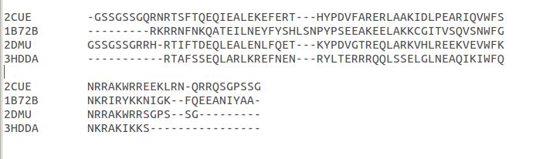
Structural Alignment
Trp (W) and Asn (N) are conserved DNA contacts between Homeodomain - DNA complexes
Notes:
We can appreciate with the structural alignment that invariable residues (Asn = N and Trp = W) that enable DNA binding are conserved .

Slide 28
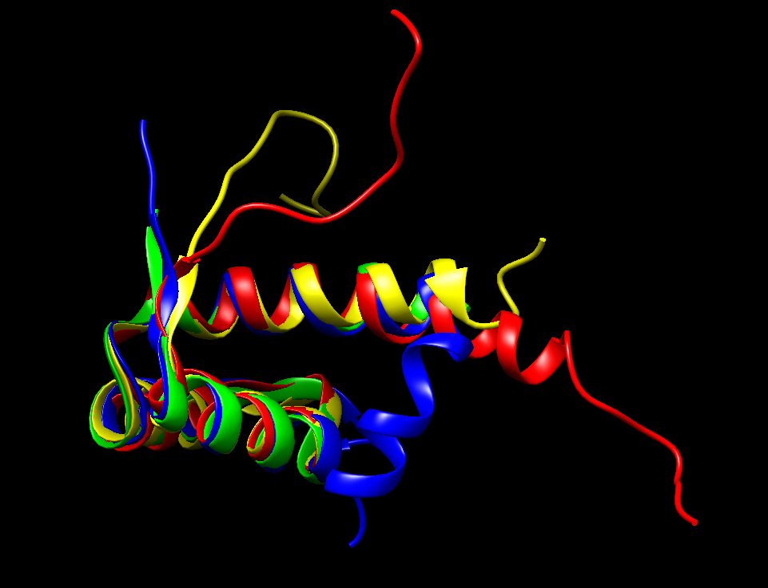
Superimposition
Sc 5.5 RMSD 0,85
Pax6 (2CUE)
Pbx1 (1B72)
Goosecoid (2DMU)
Engrailed (3HDD)

Slide 29
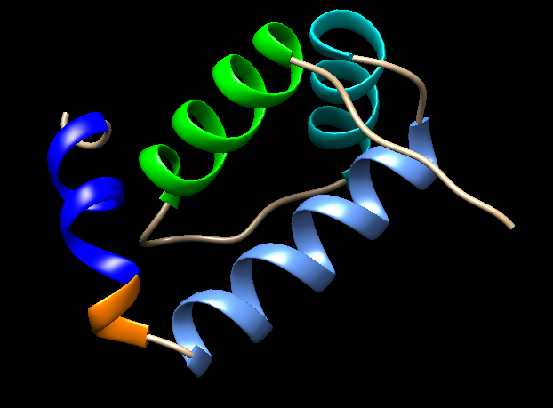
Structure of Pbx1: Four-Helix homeodomain
Helix 1
Helix 2
Helix 3
310 Helix
Helix 4
Notes:
In this image we can appreciate the general structure of the cofactor of Hoxb1, which is Pbx1 and consists of a four-helix homeodomain. Pbx1 has a binding pocket that it is important for the interaction with Hoxb1 and it is located between Helix 3 and Helix 4.
The DNA contacts are mediated by helix 3.

Slide 30
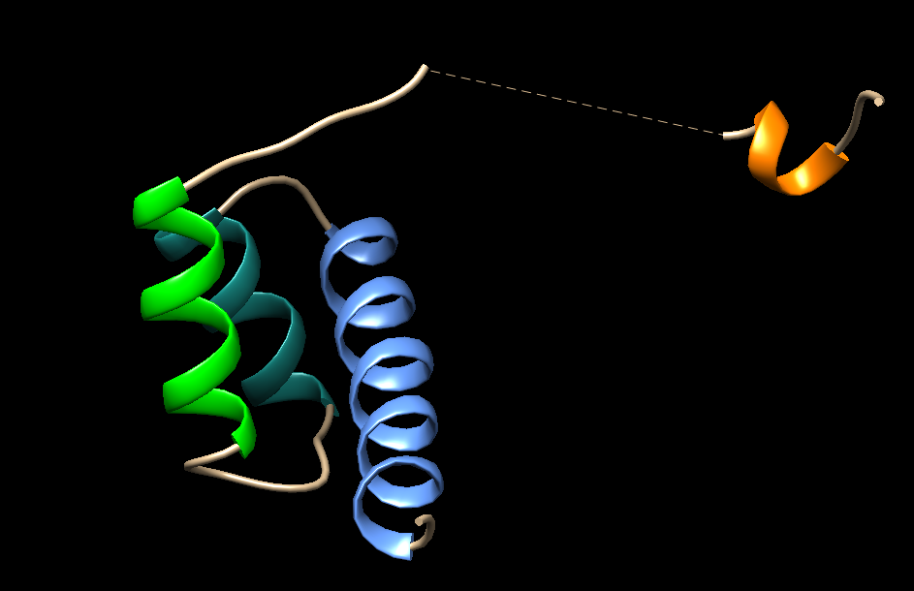
Structure of HoxB1
310 Helix
Helix 1
Helix 2
Helix 3
KRNPPKTAKVSEPGLGSPSG
Hexapeptide sequence: TFDWMK
No loop residues crystallized
Notes:
The structure of HoxB1 is the one presented in this image. Hoxb1 consists of 3 alpha helices and a small Hexapeptide sequence that forms a 310 helix. The hexapeptide sequence is of great importance to enable the cooperation of the cofactor Pbx1, as it will be explained in more detail later.
Helix 3 is responsible for establishing the DNA binding contacts.
The 20 residues sequence is variable. This concrete region is not crystallized so we couldn’t obtain a calculation of the B-factor.

Slide 31
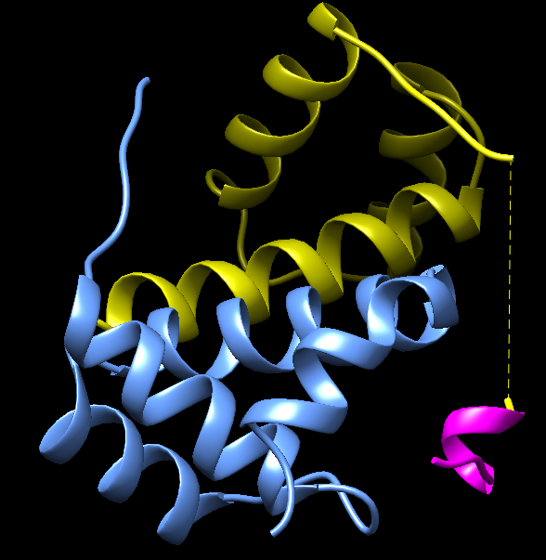
HoxB1 - Pbx1 Heterodimer
The hexapeptide binds in to Pbx1.
Contacts are important for cooperative binding.
Fundamental residues: W and M
TRP
TFDWMK

Slide 32
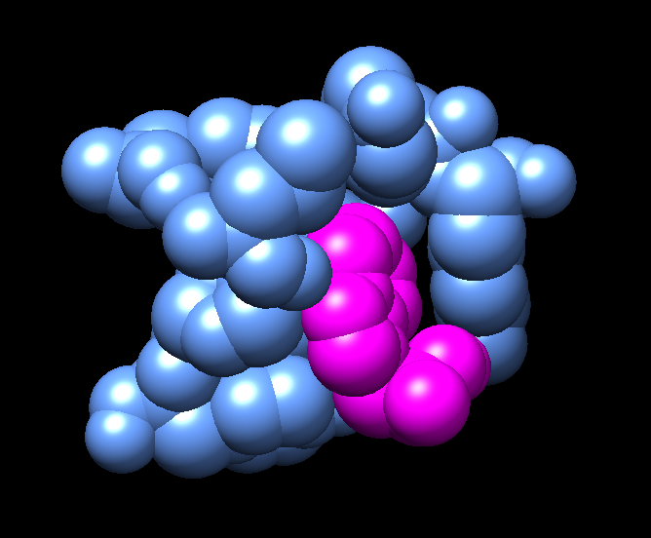
The role of Trp: Hydrophobic pocket
TYR
PHE
ARG
LEU
LYS
PRO
TRP
TYR
Notes:
The largest number of contacts are formed by Trp.
It forms Van der Waals contacts with:
Phe → helix 1
Leu, ser and Asn → 3 aa insertion
Pro and Tyr → after the 3 aa insertion
Arg, Tyr and Lys → helix 3
Strict conservation of the tryptophan and methionine residues is due to the numerous contacts that these residues mediate in the HoxB1-Pbx1 structure, which would be expected to be conserved in complexes between Pbx1 and other Hox partners.

Slide 33
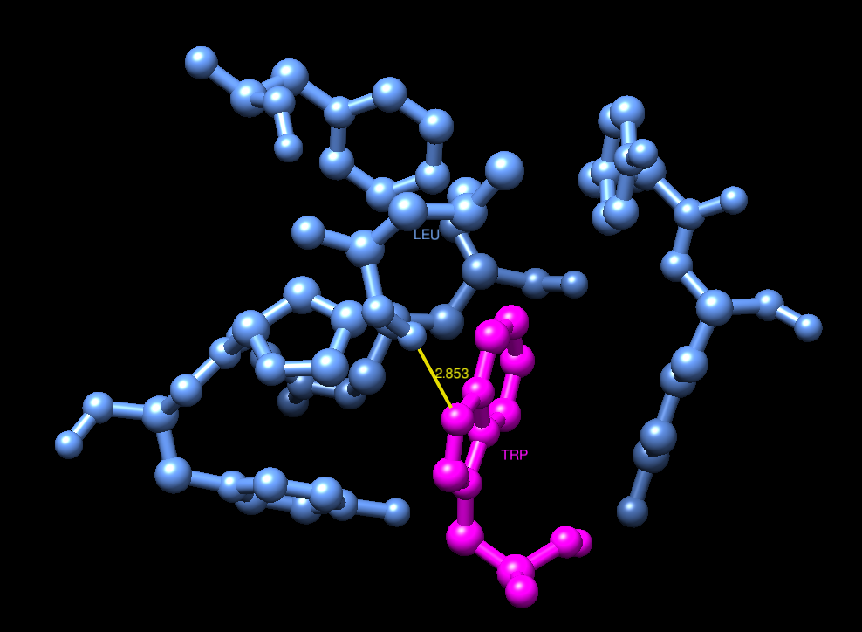
O
N
Notes:
The burial of the hexapeptide tryptophan in the Pbx1 binding pocket is further favoured by Hydrogen bonding between the indole nitrogen and the peptide backbone carbonyl of Leucine.

Slide 34
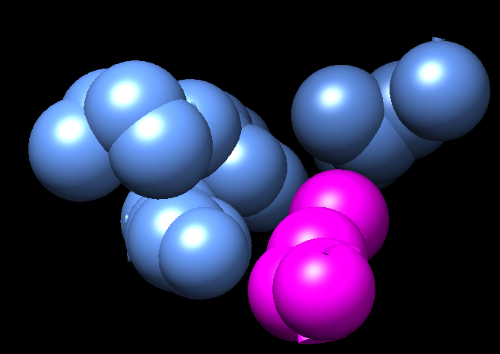
Hydrophobic contacts of Met
LEU
ILE
TYR
LYS
MET
Notes:
TRP
The hexapeptide Met side chain forms further van der waals interactions in the binding pocket, interacting with Pbx1 side chain Leu in the 3 aa insertion, with Tyr, and Lys in helix 3. And with Leu in the turn following helix 3.

Slide 35
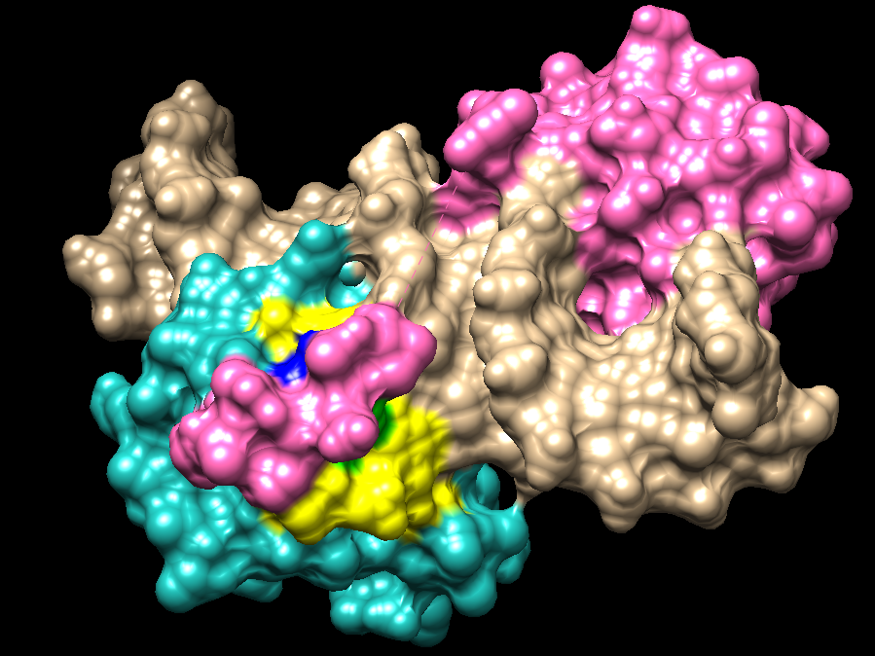
HoxB1
Pbx1
DNA
Trp Met
Hydrophobic region
Notes:
In this image, coloured in yellow, we can appreciate the hydrophobic surface of the heterodimer.

Slide 36
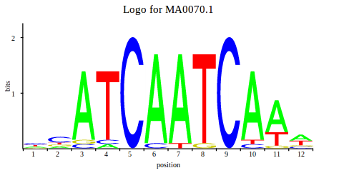
Homeodomain DNA complexes
Heterodimer binding sequence
5’- A T G A T T G A T C G - 3’
3’- T A C T A A C T A G C - 5’
7
Base preference at position 7 of the binding site. HoxB1 prefers a G.
Greater role in determining the DNA binding site of the heterodimer.
Notes:
HoxB1 and Pbx1 bind in tandem to overlapping DNA sites, containing the 11 bp Heterodimer sequence: 5’ - ATGATTGATCG - 3’
Base preference at position 7 of the binding site strongly dependent on the identity of the Hox protein. Hox B1 prefers a G at position 7.
When we searched for the homeodomain sequence in Jaspar we found out the sequence of the complementary chain.

Slide 37
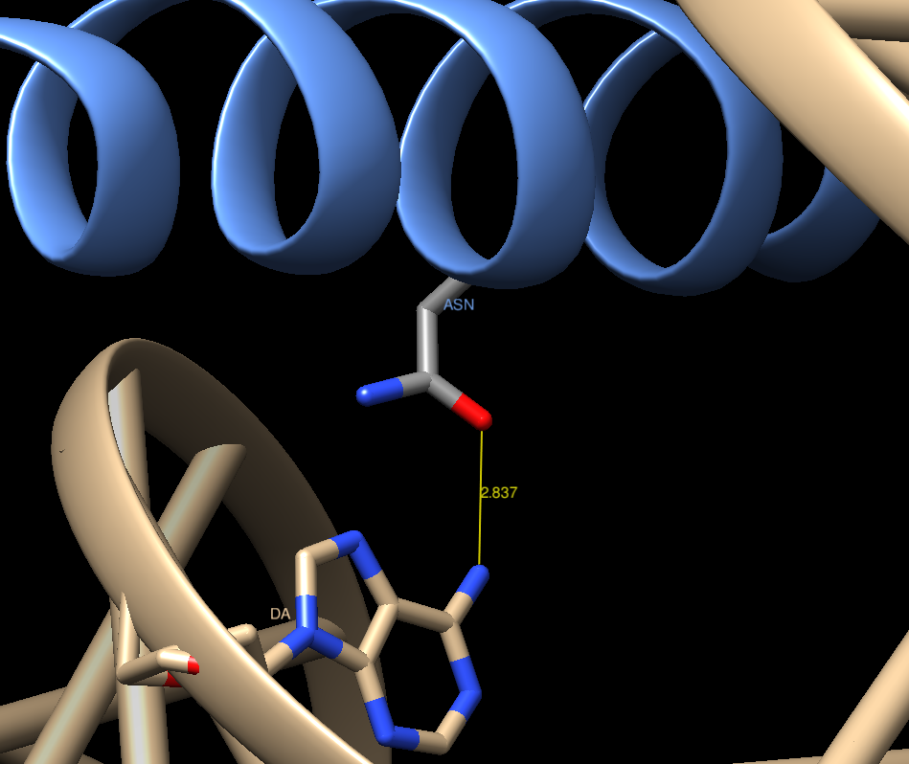
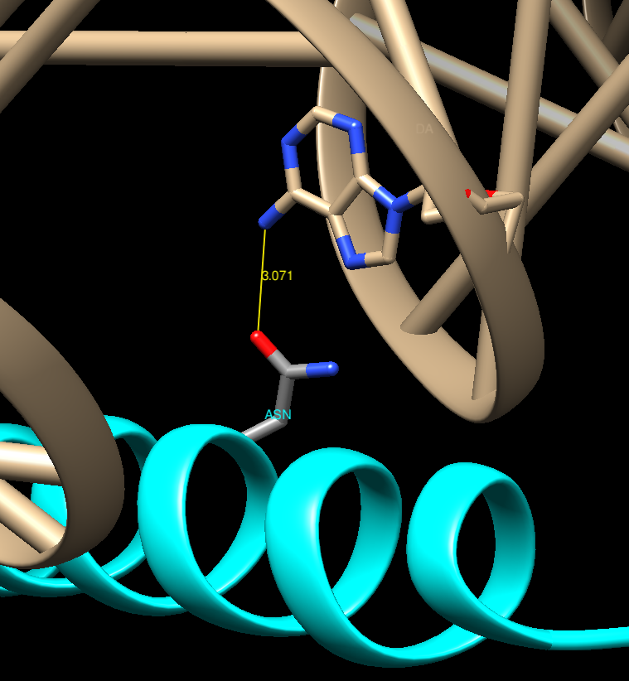
Homeodomain DNA complexes
Each homeodomain forms a set of conserved DNA contacts that have been observed in other Homeodomain - DNA complexes.
  Hydrogen bond between Adenine base and Asn.
A
Pbx1
Asn-286
Asn
A
HoxB1
Notes:
Each homeodomain forms a set of DNA contacts that have been observed in other homeodomain-DNA complexes. One of the most important ones is the hydrogen bond established between Asn and A, which is present in both proteins. It is a very conserved region as it can be seen in the structural alignment.

Slide 38
Structural Alignment
Asn (N) is a conserved DNA contact between Homeodomain - DNA complexes
Notes:
We can appreciate with the structural alignment that invariable residues (Asn = N and Trp = W) that enable DNA binding are conserved .

Slide 39
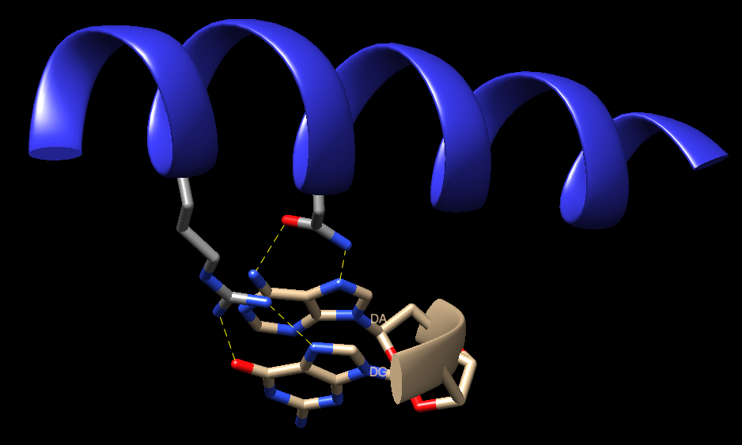
DNA contacts formed by Pbx1: Hydrogen bonds
ARG
ASN
Notes:
In this image we can observe that the invariant asparagine forms 2 hydrogen bonds with the base pair adenine. Arginine also forms 2 hydrogen bonds with guanine.

Slide 40
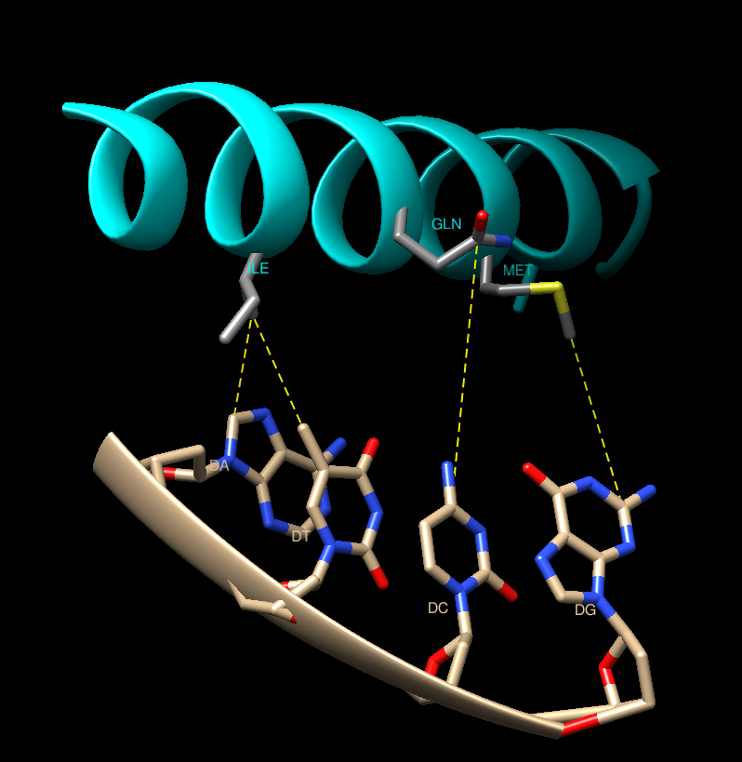
DNA contacts formed by HoxB1
Notes:
In HoxB1, in addition to the major groove contacts formed by the Asn with Adenine, van der waals contacts are formed:
Ile → Adenine and Timine.
Met → Guanine
Gln (glutamina) → citosine

Slide 41
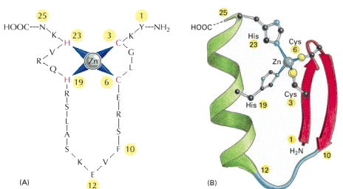
Zinc finger
Small protein domains. Zinc plays a structural role.
Structurally diverse: present among proteins that perform a broad range of functions.
Classical zinc finger: Cys₂His₂
  Very abundant in eukaryotic genomes.
  ββα framework
Alberts B, Johnson A, Lewis J, et al. Molecular Biology of the Cell. 4th ed. New York: Garland Science; 2002.

Slide 42
SCOP classification
Class | Small proteins usually dominated by metal ligand, heme, and/or disulfide bridges
Fold | beta-beta-alpha zinc fingers simple fold, N-terminal beta-hairpin C-terminal alpha-helical region; each part provides two zinc-coordinating residues with the observed sequences including C2H2,C2HC, CHHC
Superfamily | beta-beta-alpha zinc fingers
Family | Classic zinc finger, C2H2

Slide 43
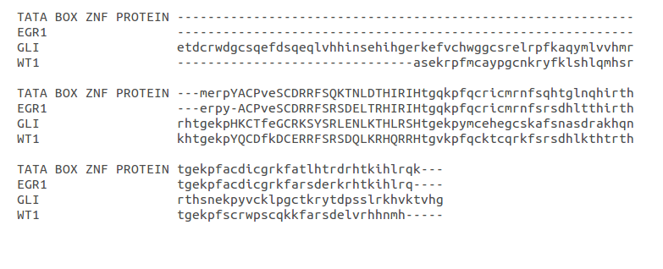
Multiple Sequence Alignment (hmmalign)
Zn finger motif: Ar-X-C-X2-4-C-X3-Ar-X5-L-X2-H-X3-4-H

Slide 44
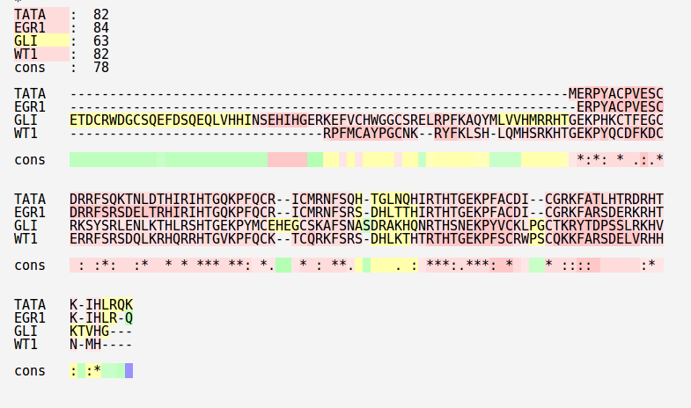
Multiple Sequence Alignment (t-coffee)
Zn finger motif: Ar-X-C-X2-4-C-X3-Ar-X5-L-X2-H-X3-4-H

Slide 45
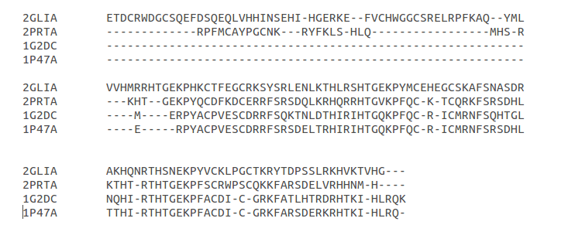
Structural Alignment
Zn finger motif: Ar-X-C-X2-4-C-X3-Ar-X5-L-X2-H-X3-4-H

Slide 46
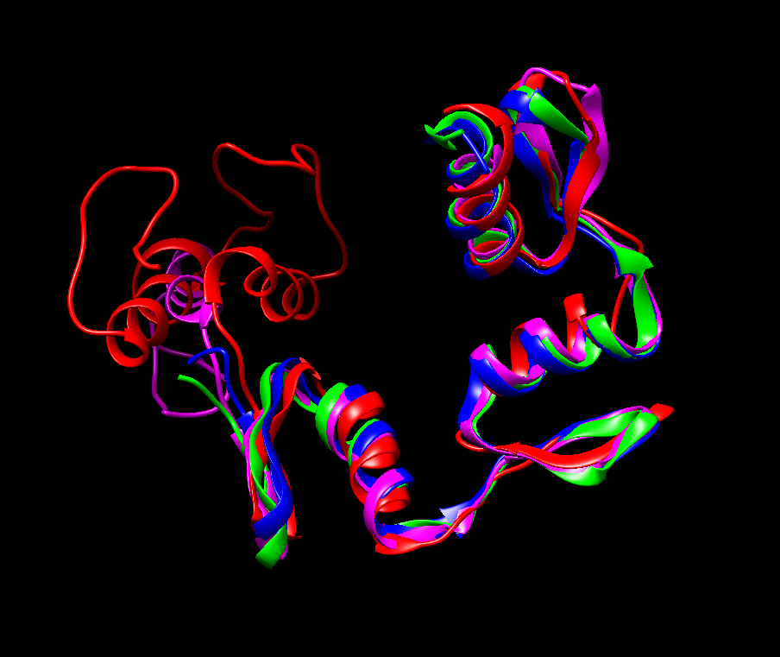
Superimposition
Sc 5.36 RMSD 1.70
Tata Box ZNF (1G2D)
EGR1 (1P47)
GLI (2GLI)
WT1 (2PRT)
Notes:
fet amb alignfit
posar RMSD
Altra imatge → per estructura (amb color diferent els residus conservats amb la cadena lateral)

Slide 47
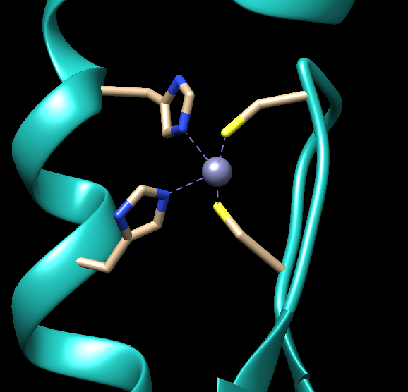
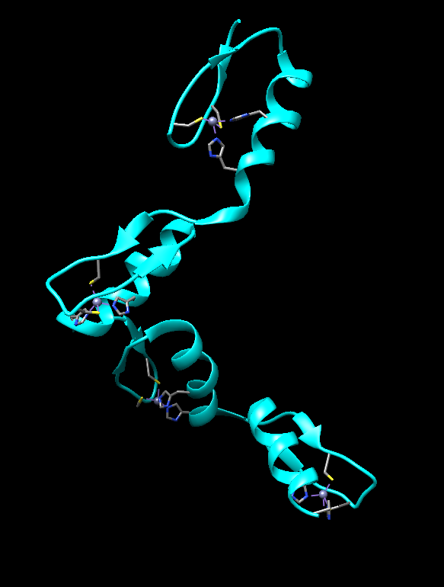
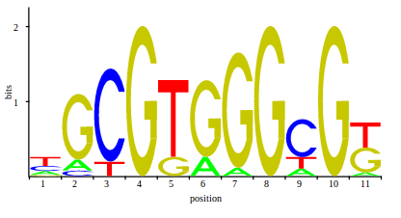
Wilms tumor suppressor protein WT1
Contains 4 Cys2His2 Zn fingers
WT1 binds preferentially to EGR-1 consensus site
1
2
Zn fingers 2,3,4 : make base-specific interactions with DNA
Zn finger 1: helps to anchor WT1 to DNA
3
4

Slide 48
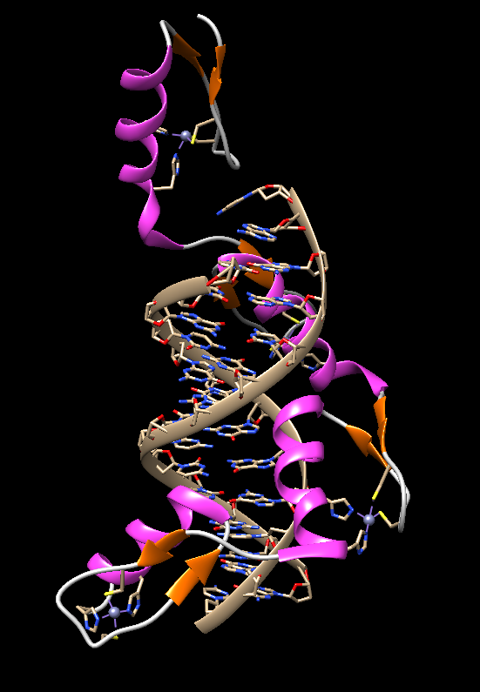


Slide 49


ββα fold

Slide 50

zf2 interacts with DNA: specific interactions
Arg 366
Arg 372
Notes:
Fer imatge individuals de cada tipus d’enllaç
MIrar si es un punt en comú entre purines o pirimidines → mirar si es específic del tot o només entre els 2 grups

Slide 51

zf3 interacts with DNA: specific interactions
Asp 396
Arg 394
His 397

Slide 52

zf4 interacts with DNA
Arg 424
Arg 430

Slide 53
R366
R372
R424
H397
R394
R424
3’ G C G G G G G G C G 5’
5’ C G C C C C C C G C 3‘
R366
R372
D396

Slide 54

Basic Leucine zipper motif
B-ZIP TFs are exclusively eukaryotic proteins
A long bipartite α helix 60-80 aa long.
  N-terminal: basic aa responsible for sequence-specific DNA binding.
  C-terminal: amphipatic region with a Leu every 7 aa → Leucine zipper.
B-ZIP TF can form homo- and heterodimers through the leucine zipper region.
Alberts B, Johnson A, Lewis J, et al. Molecular Biology of the Cell. 4th ed. New York: Garland Science; 2002.

Slide 55
SCOP classification
Class | Coiled coil proteins (not a true class)
Fold | Parallel coiled-coil (not a true fold)
Superfamily | Leucine zipper domain
Family | Leucine zipper domain

Slide 56

B-ZIP dimerization
Leucine zipper domain: 4-5 heptads
-a and d aa: hydrophobic residues
Hydrophobic core
Leu in d position
-g and e aa: charged
Interhelical electrostatic interactions
-b, c, f: form the hydrophilic surface
a,d,g and e positions: determine the specificity of the interaction
Notes:
Dibuixar surface
Per cadenes
es veu com les dues cadenes estan totalment unides
centrar-se en un heptad: foto només d’aquest

Slide 57

Multiple Sequence Alignment
Basic region
Coiled-coil

Slide 58

Structural Alignment
Basic region
Coiled-coil

Slide 59

Superimposition
Sc 8.44 RMSD 1.47
Creb (1DH3)
Gcn4 (1DGC)
Fos (1FOS)
Jun (1FOS)
Notes:
Creb (1DH3) Mus musculus
Gcn4 (1DGC) Saccharomyces cerevisiae
Jun and Fos (1FOS) Homo sapiens

Slide 60



c-Jun:c-Fos heterodimer
FOS (1FOS)
JUN (1FOS)
FOS (1FOS)
JUN (1FOS)
Conformation I
Conformation II
Binds DNA AP-1 site
5’- T C T C C T A T G A C T C A T C C A T -3’
3’- A G A G G A T A C T G A G T A G G T A -5’

Slide 61

Notes:
We can see here that Jun and Fos form an heterodimer thanks to hydrophobic and electrostatic interactions which avoids the presense of water inside the structure.

Slide 62

Hydrophobic interactions
Val 293
Leu 172
Notes:
Hydrophobic interaction between Val293 of Jun (in a position of the heptad) and Leu172 of Fos (in d position of the heptad)

Slide 63

Interhelical electrostatic interactions
Lys 297
Glu 168
Lys 292
Glu 173
Notes:
Lys292 interacts with Glu173
Lys 297 interacts with Glu 168

Slide 64

Jun-AP1 site: hydrogen bonds
Arg 279
Asn 271

Slide 65

Jun-AP1 site: van der Waals interactions
Ala 275
Ala 274

Slide 66
Multiple Sequence Alignment
A274
5’- T G A C T C A -3’
3’- A C T G A G T -5’
Asn271 and Arg279
Ala274 and Ala275
N271
A275
R279

Slide 67
Conclusions
TF can have multiple domains.
There are specific and unspecific interactions between TF and DNA.
Essential residues for TF- DNA interactions are conserved in the different families.
Superimposition was difficult due to the fact that proteins were small and simple.
Interaction predictions are not always precise.
Notes:
TF poden tenir múltiples dominis, ens hem centrat en el DNA-binding domain
Veiem interaccions inespeciífiques i específiques

Slide 68
Multiple Choice Questions
1) A form of binding motif containing a nearly identical sequence of 60 amino acids in many eukaryotes is the:
a. Homeodomain motif
b. Leucine zipper motif
c. Universal motif
d. Zinc finger motif
e. All of them
2) When a homeodomain binds to DNA, the actual binding portion of the homeodomain is:
a. The operon
b. Zinc finger
c. Histine
d. Leucine
e. Helix-turn-helix motif
3) In the zinc fingers motif, the spacing of the helical segments is performed by:
a. Zinc atoms
b. Beta-beta sheets
c. Gamma helices
d. Alpha helix
e. a and c
4) The leucine zipper motif involves the cooperation of two:
a. Leucines
b. Polimerases
c. Histones
d. RNA chains
e. Proteins
5) WT1 Zn finger domain contains:
a. C2HC Zn fingers
b. CHHC Zn fingers
c. C2H2 Zn fingers
d. L2H2 Zn fingers
e. LHHL Zn fingers
Notes:
5 WT1 Zn finger domain contains:
a. C2H2 Zn fingers
b. CHHC Zn fingers
c. C2H2 Zn fingers
d. L2H2 Zn fingers
e. LHHL Zn fingers

Slide 69
Multiple Choice Questions
6) Hydrophobic interactions between Jun and Fos Leucine zipper domains involve:
a and d residues of the heptads
a and e residues of the heptads
g and e residues of the heptads
a and g residues of the heptads
f and g residues of the heptad
7) WT1 binds preferentially to DNA sequences that are closely related to:
E-box
AP-1 consensus site
TATA-box
Pbx1-HoxB1 binding site
EGR-1
8) The contacts made with the phosphates of the DNA are:
a. Specific contacts
b. π stacking
c. Unspecific contacts
d. Water mediated contacts
e. Hydrophobic contacts
9) b/HLH proteins bind to DNA through the region:
a. Helix 1 (H1)
b. Basic region
c. Helix 2 (H2)
d. Loop
e. All of the above
10) Which programme predicts residues that bind to DNA :
a. Displar
b. Stamp
c. i- Tasser
d. T-coffee
e. Xam

Slide 70
PDB’s
HELIX – LOOP - HELIX
Name | PDB ID
Max protein | 1NLW
Myc | 1NKP
SREBP1A | 1AM9
MyoD | 1MDY
HOMEODOMAIN
Name | PDB ID
Pax6 | 2CUE
Goosecoid | 2DMU
Engrailed | 3HDD
HoxB1-Pxb1 | 1B72

Slide 71
ZINC FINGERS
Name | PDB ID
Tata box Zinc finger protein | 1G2D
EGR1 | 1P47
Gli | 2GLI
WT1 | 2PRT
WT1 | 2JP9
LEUCINE ZIPPER
Name | PDB ID
Gcn4 | 1DGC
Creb | 1DH3
Fos | 1FOS_G
Jun | 1FOS_H

Slide 72
References
Yura K, Tomoda S, Go M. Repeat of a helix-turn-helix module in DNA-binding proteins. Protein Eng. 1993 Aug;6(6):621-8.
Aravind L, Anantharaman V, Balaji S, Babu MM, Iyer LM. The many faces of the helix-turn-helix domain: transcription regulation and beyond. FEMS Microbiol Rev. 2005 Apr;29(2):231-62.
Alberts B, Johnson A, Lewis J, et al. Molecular Biology of the Cell. 4th edition. New York: Garland Science; 2002.
Vinson C, Myakishev M, Acharya A, Mir AA, Moll JR, Bonovich M. Classification of Human B-ZIP Proteins Based on Dimerization Properties. Mol Cell Biol 2002;22(18):6321-6335.
Llorca CM, Potschin M, Zentgraf U. bZIP and WRKYs: two large transcription factor families executing two different functional strategies. Front Plant Sci. 2014; 5:169
Luscombe NM, Laskowski RA, Thornton JM. Amino acid- base interactions: a three-dimensional analysis of protein-DNA interactions at an atomic level. Nucleic Acids Res. 2001; 29(13):2860-2874
Kise KJ, Shin JA. The contribution of methyl groups on thymine bases to binding specificity and affinity by alanine-rich mutants of the bZIP motif. Bioorg Med Chem. 2001; 9(9):2485-2491.
Laity JH, Lee BM, Wright PE. Zinc finger proteins: new insights into structural and functional diversity. Curr Opin Struct Biol. 2001 Feb;11(1):39-46.
Stoll R, Lee BM, Debler EW, Laity JH, Wilson IA, Dyson HJ, Wright PE. Structure of the Wilms tumor suppressor protein zinc finger domain bound to DNA. J Mol Biol. 2007;372(5):1227-45

Slide 73
References
Alberts B, Johnson A, Lewis J, et al. Molecular Biology of the Cell. 4th ed. New York: Garland Science; 2002.
Piper DE, Batchelor AH, Chang CP, Cleary ML, Wolberger C. Structure of a HoxB1-Pbx1 heterodimer bound to DNA: role of the hexapeptide and a fourth homeodomain helix in complex formation. Cell. 1999 Feb 19;96(4):587-97.
Phillips SE. Built by association: structure and function of helix-loop-helix
DNA-binding proteins. Structure. 1994 Jan 15;2(1):1-4.
Ma PC, Rould MA, Weintraub H, Pabo CO. Crystal structure of MyoD bHLH
domain-DNA complex: perspectives on DNA recognition and implications for
transcriptional activation. Cell. 1994 May 6;77(3):451-9.

