Slide 1
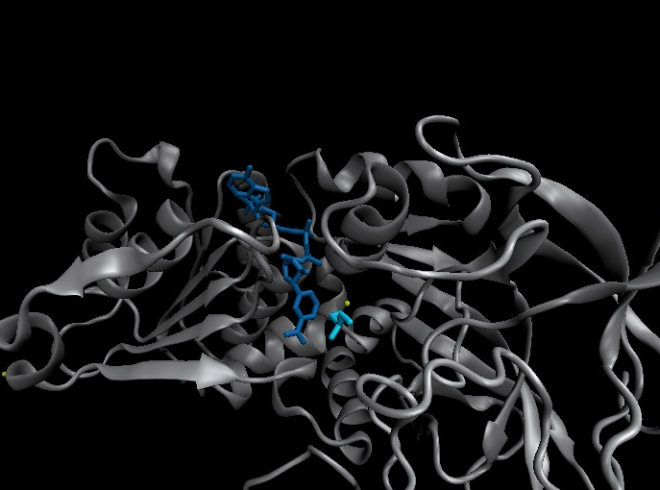
Nicotinamide adenine dinucleotide binding proteins
Blanca Risa
Gemma Serra
Xaloc Téllez
Anna Troya
CURS 2013- 2014
GRAU EN BIOLOGIA HUMANA

Slide 2
Index
Introduction
  Enzymes that bind nucleotides
  NAD(P) – NAD(P)H
  NAD-binding proteins
  What do we study?
Sequence identity
Structure
  NAD-binding enzymes and classical Rossmann fold
  Superimpositions
  Fingerprint core
  Function
  Cofactor interactions
  Cofactor orientation
  Stereospecific transfer
Conclusions

Slide 3
Introduction
Enzymes that bind nucleotides
Some enzymes require non-protein molecules called cofactors for activity
Nucleotides play a central role in cellular metabolism
Nucleotides can be involved in two different energy transfer processes:
High-energy phosphate bonds in triphosphates:
- ATP
- GTP
Oxidation-reduction (redox):
- Flavin: FAD and FMN
- Nicotinamide: NAD and NADP

Slide 4
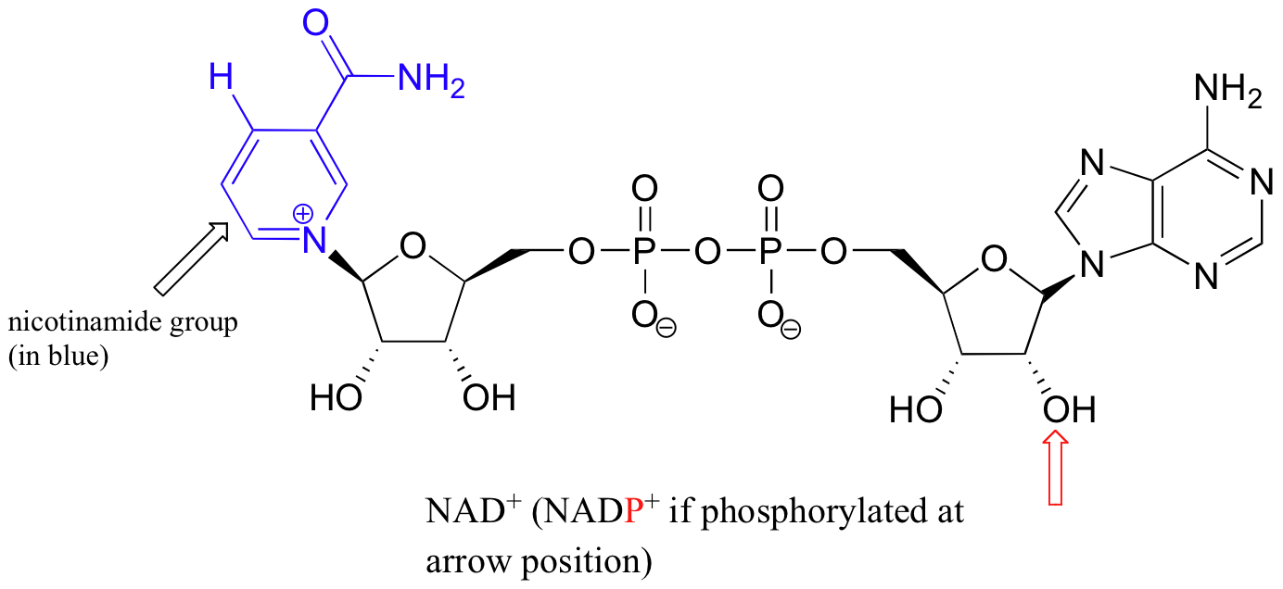
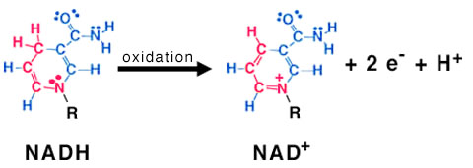
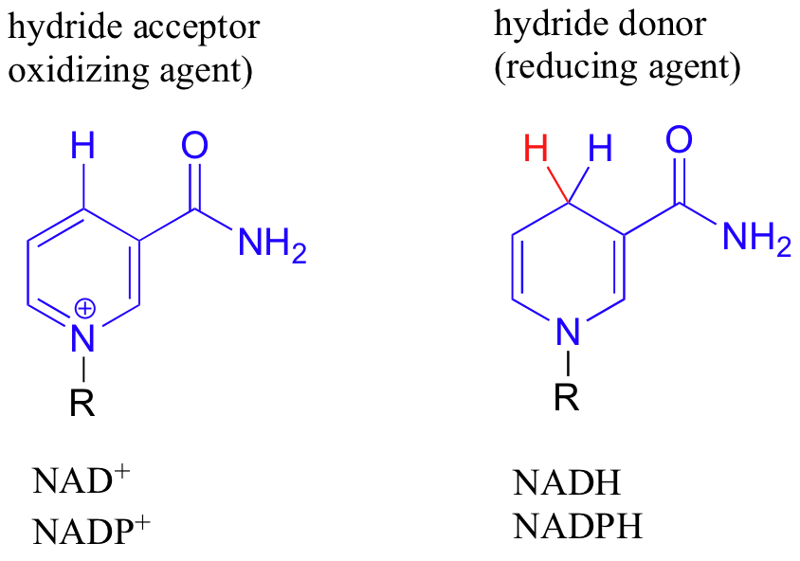
Introduction
NAD(P)-NAD(P)H
NAD molecule comprises:
Nicotinamide ribose phosphate (NMN): H addition.
Adenine ribose phosphate (AMP)
Linked through a pyrophosphate bond
NADP has additional phosphate group
NAD(P): oxidizing agents
NAD(P)H: reducing agents.
NAD⁺
NADP⁺
NADH
NADPH

Slide 5
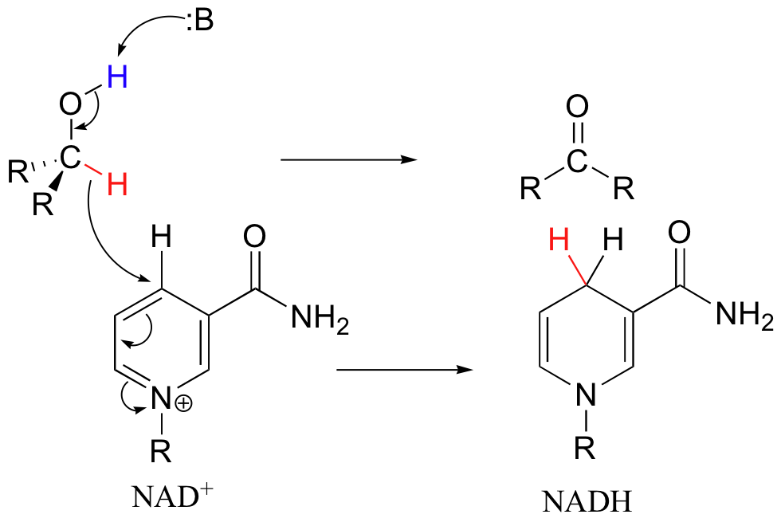
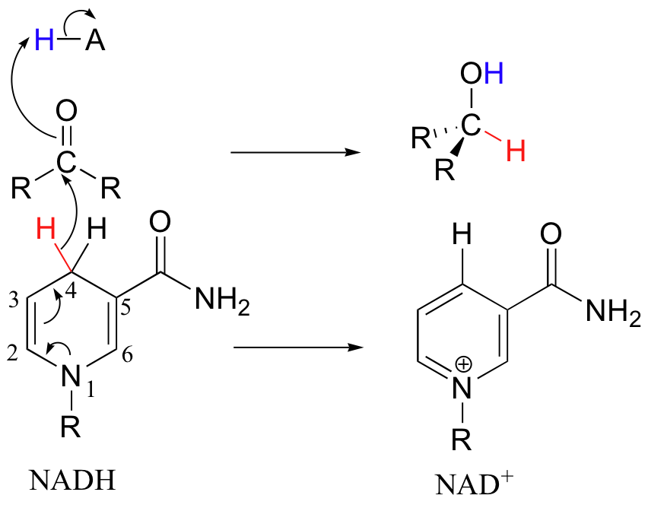
Introduction
Chemical reactions
OXIDATION reactions
REDUCTION reactions
+
ketone
Alcohol
ketone
Alcohol
- 2e⁻
+ 2e⁻
Reduction of NAD to NADH
Oxidation of NADH to NAD

Slide 6
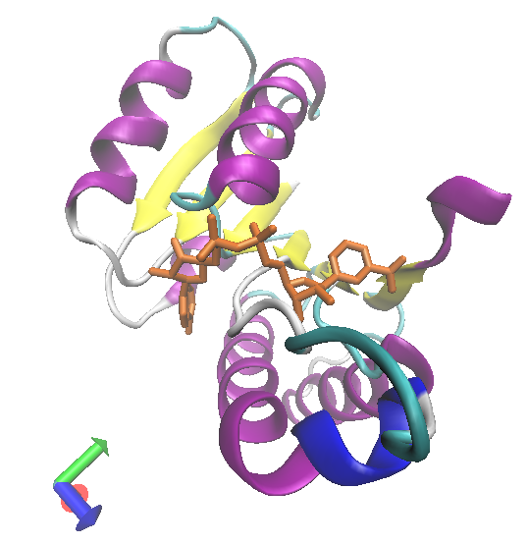
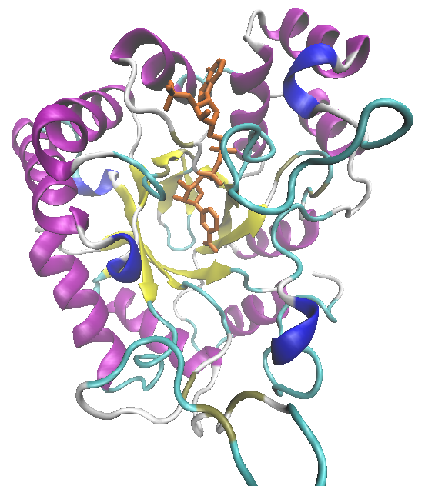
NAD(P)-Binding enzymes
NAD(P)-binding enzymes
NAD(P)-binding proteins are ubiquitous
There are several distinct ways of binding NAD(P):
Rossmann fold
Beta Barrel
NON CLASSICAL
All-Alpha
All-Beta
Alpha + Beta
Alpha/Beta
CLASSICAL
Alpha/beta
Aldose reductase
Malate dehydrogenase

Slide 7
What do we study?
Class: Alpha and beta protein (α/β)
Superfamily: NAD(P)-Binding Rossmann fold domains
Family | Protein | Species | PDB ID
Alcohol dehydrogenase-like | Alcohol dehydrogenase | Equus caballus | 2OHX
 | Alcohol dehydrogenase | Rana perezi | 1P0F
Formate/glycerate dehydrogenases | L-alanine dehydrogenase | Phormidium lapideum | 1PJC
 | Formate dehydrogenase | Pseudomonas sp. | 2NAD
LDH N-terminal domain-like | Malate dehydrogenase | Escherichia coli | 1EMD
 | Lactate dehydrogenase | Thermotoga maritima | 1A5Z
6-phosphogluconate dehydrogenase-like | Prephenate dehydrogenase | Synechocystis sp. | 2F1K
Siroheme synthase | Siroheme synthase CysG | Salmonella typhimurium | 1PJS
Ornithine cyclodeaminase-like | Ornithine cyclodeaminase | Pseudomonas putida | 1X7D
Tyrosine-dependent oxidoreductases | Uridine diphosphogalactose-4-epimerase | Homo sapiens | 1EK5
Amino acid dehydrogenase-like | Glutamate dehydrogenase | Pyrobaculum islandicum | 1V9L
Glyceraldehyde-3-phosphate dehydrogenase-like | Glyceraldehyde-3-phosphate dehydrogenase | Escherichia coli | 1GAD
Transcriptional repressor Rex | Transcriptional repressor Rex | Thermus aquaticus | 1XCB
CoA-binding domain | Succinyl-CoA synthetase | Thermus thermophilus | 1OI7
Potassium channel NAD-binding domain | Ktn Mja218 | Archaeon Methanococcus jannaschii | 1LSS
They can have different functions and catalyse similar or different reactions related to oxidoreduction

Slide 8
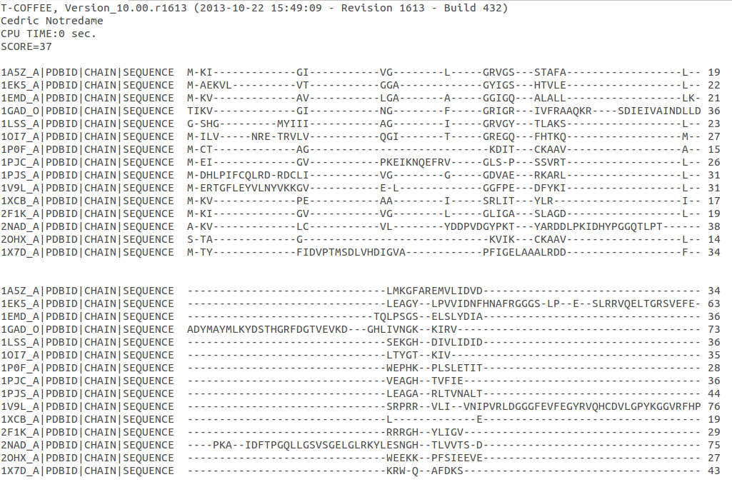
Sequence identity
MSA: Whole sequence
MSA with whole sequence of 2OHX, 1P0F, 1PJC, 2NAD, 1PJS, 1EMD, 1A5Z, 2F1K, 1LSS, 1XCB, 1X7D, 1OI7, 1GAD, 1EK5, 1V9L

Slide 9
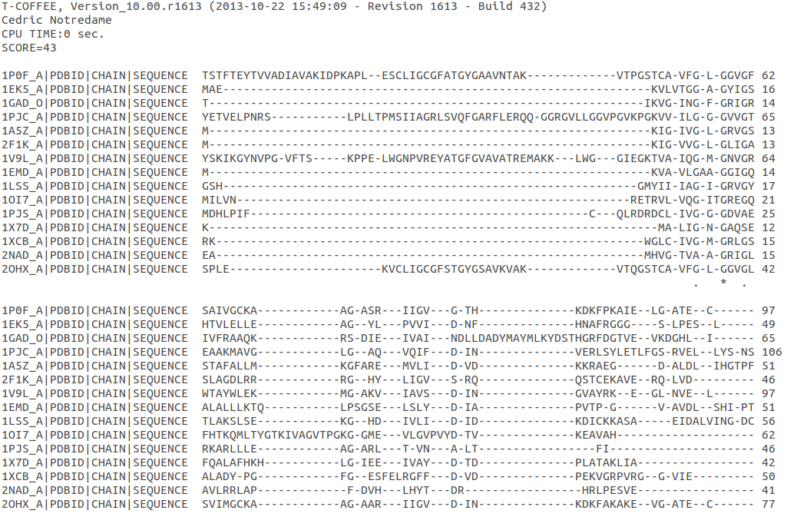
Sequence homology
MSA: Rossmann fold
MSA with Rossmann fold of 2OHX, 1P0F, 1PJC, 2NAD, 1PJS, 1EMD, 1A5Z, 2F1K, 1LSS, 1XCB, 1X7D, 1OI7, 1GAD, 1EK5, 1V9L

Slide 10
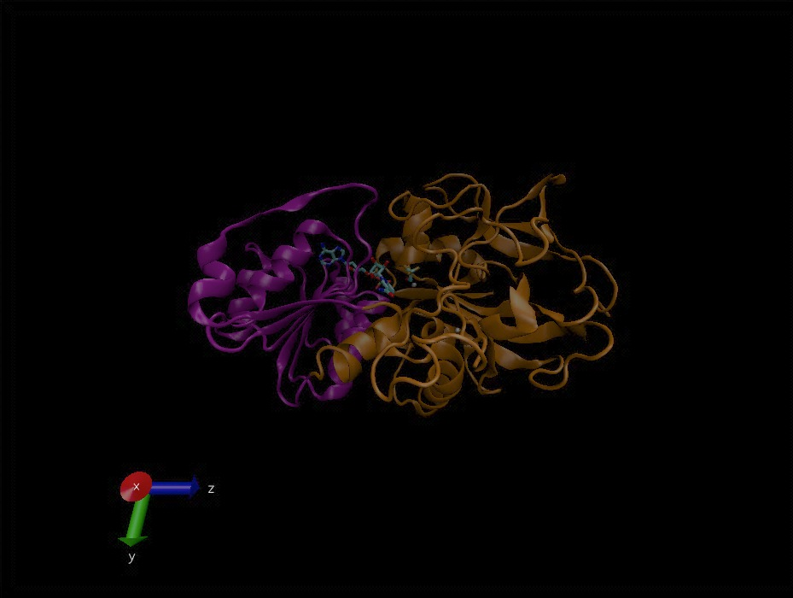
Structure
NAD(P)-binding enzymes
Large protein molecules which can have several identical polypeptide chains
Two separated domains (or more):
Catalytic domains: binds to the substrate
NAD(P)- Binding domain
In different regions of the polypeptide chain
Have similar 3D structures.
Alcohol dehydrogenase

Slide 11
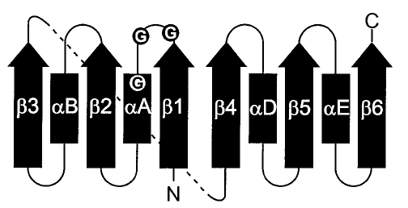
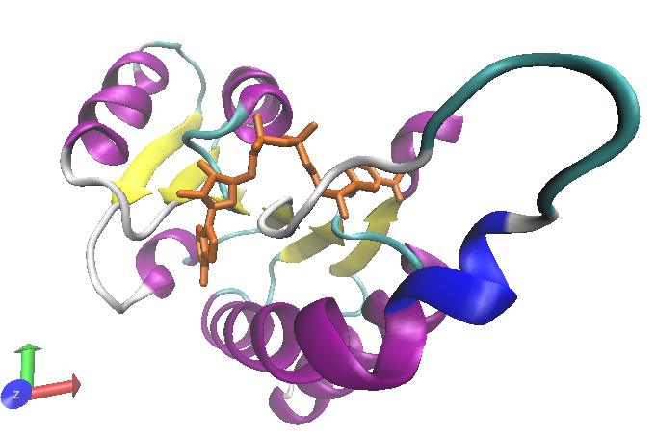
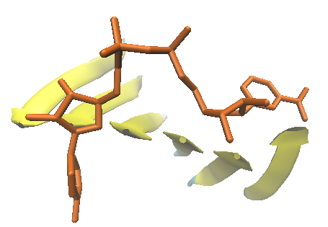
Structure
NAD-binding classical fold
Two Rossmann fold motifs (βαβαβ motifs)
Crossover connection: α-helix (not always)
Open parallel 6-stranded β-sheet (321456) with α-helices on both sides
Topological switch point

Slide 12
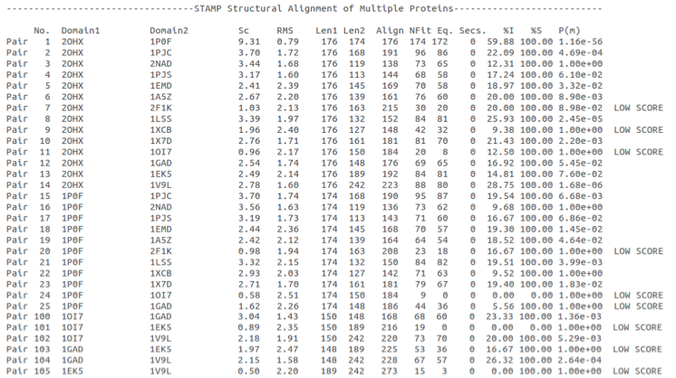
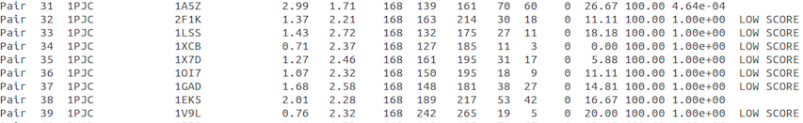
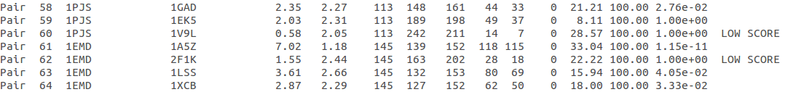
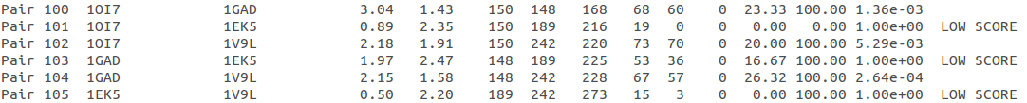
Structure
Superimposition of Rossmann fold
33/105
RMSD
<2: 44
>2 i <3: 61
Sc
5.5-9.8: 2
2.5-5.5: 51
< 2.5: 52
(….)
(….)
(….)
Superimposition of 2OHX, 1P0F, 1PJC, 2NAD, 1PJS, 1EMD, 1A5Z, 2F1K, 1LSS, 1XCB, 1X7D, 1OI7, 1GAD, 1EK5, 1V9L

Slide 13
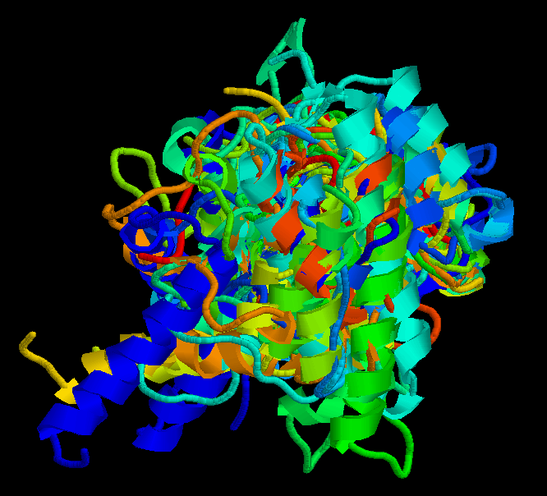
Structure
Superimposition of Rossmann fold
The overall topologies of the NAD-binding domain show variations:
Additional beta strands
Different helix length
Different loops
Crossover region variable in structure (α-helix)
Not all the 6 strands are essential to NAD- binding
Rasmol display of the superimposition of 2OHX, 1P0F, 1PJC, 2NAD, 1PJS, 1EMD, 1A5Z, 2F1K, 1LSS, 1XCB, 1X7D, 1OI7, 1GAD, 1EK5, 1V9L

Slide 14
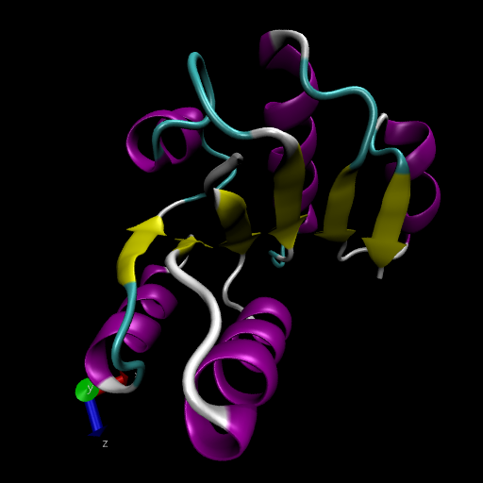
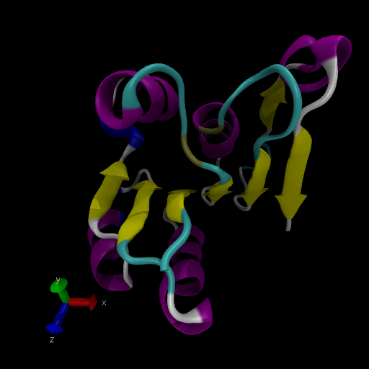
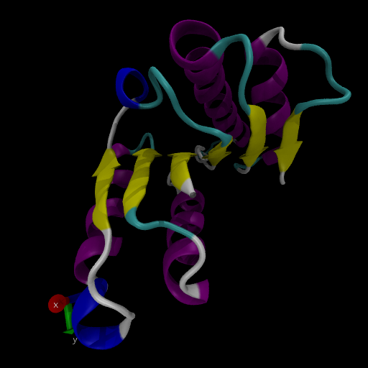
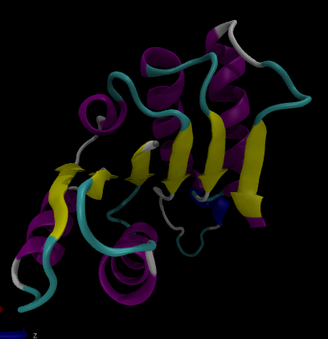
Structure
Differences in the Rossmann fold
Classical Rossmann fold
Ktn Mja218
Alcohol dehydrogenase
Malate dehydrogenase
Lactate dehydrogenase

Slide 15
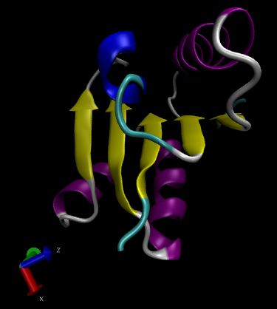
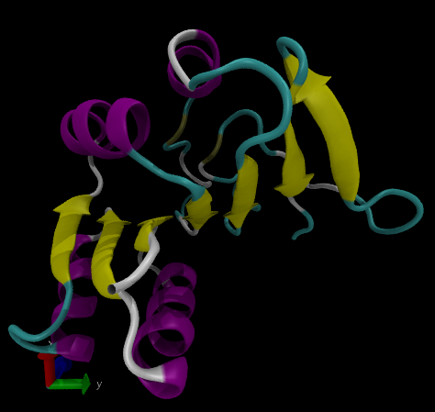
Structure
Differences in the Rossmann fold
Different number of β-strands
5
6
6
5
4
3
4
1
7
2
3
2
4
5
1
3
2
1
L-alanine dehydrogenase
Siroheme synthase CysG

Slide 16
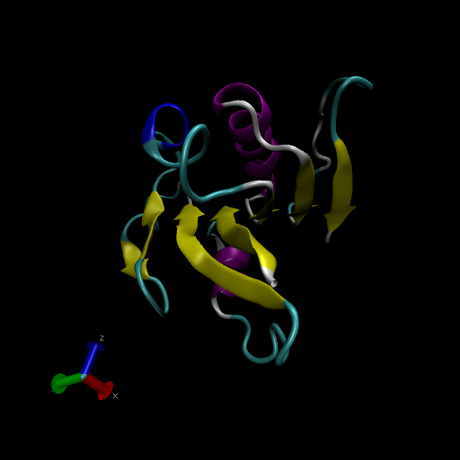
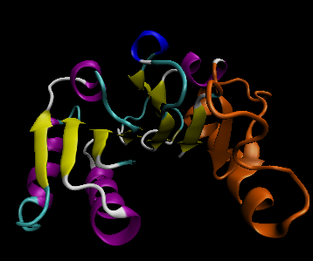
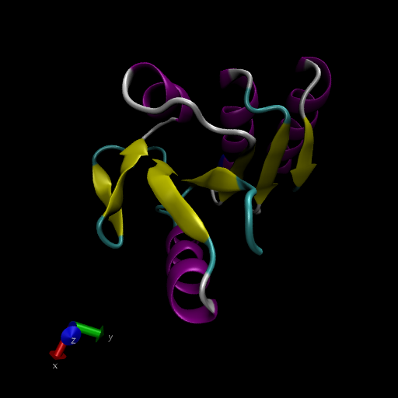
Structure
Differences in the Rossmann fold
Ornithine cyclodeaminase
6
4
5
3
1
2
Transcriptional repressor Rex
4
5
6
3
2
1
6
4
5
3
1
2
Succinyl CoA synthetase

Slide 17
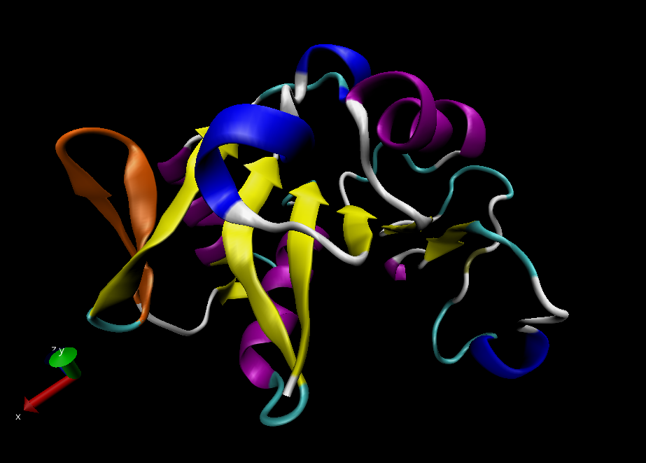
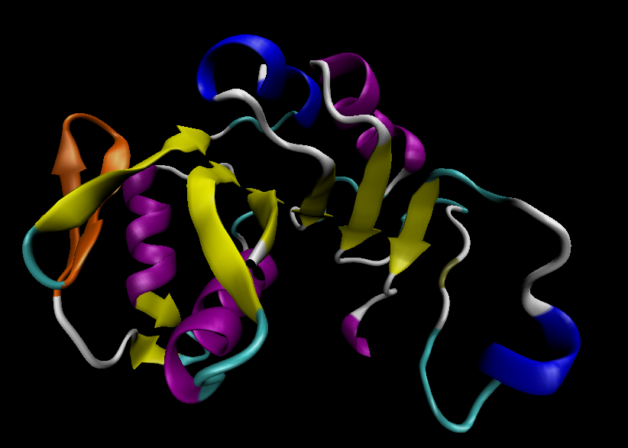
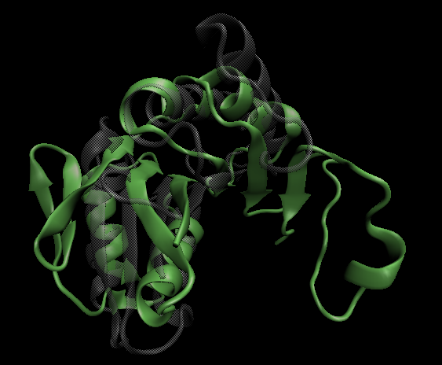
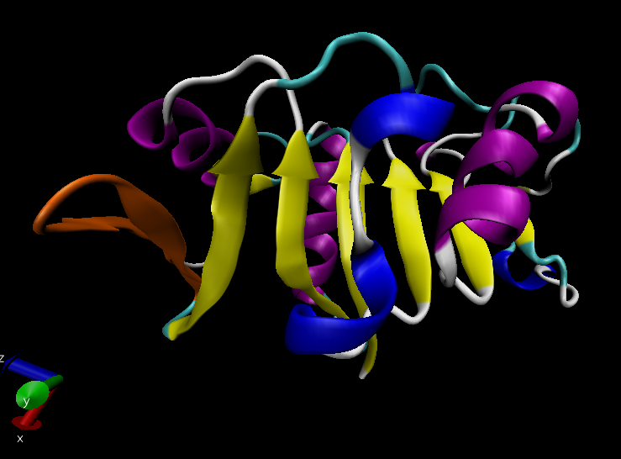
Structure
Differences in the Rossmann fold
Glyceraldehyde-3-phosphate dehydrogenase
4, 5
1
6
7
3
2
8
Superimposition of 1GAD (glyceraldehyde 3-phosphate dehydrogenase) and 2OHX (alcohol dehydrogenase)

Slide 18
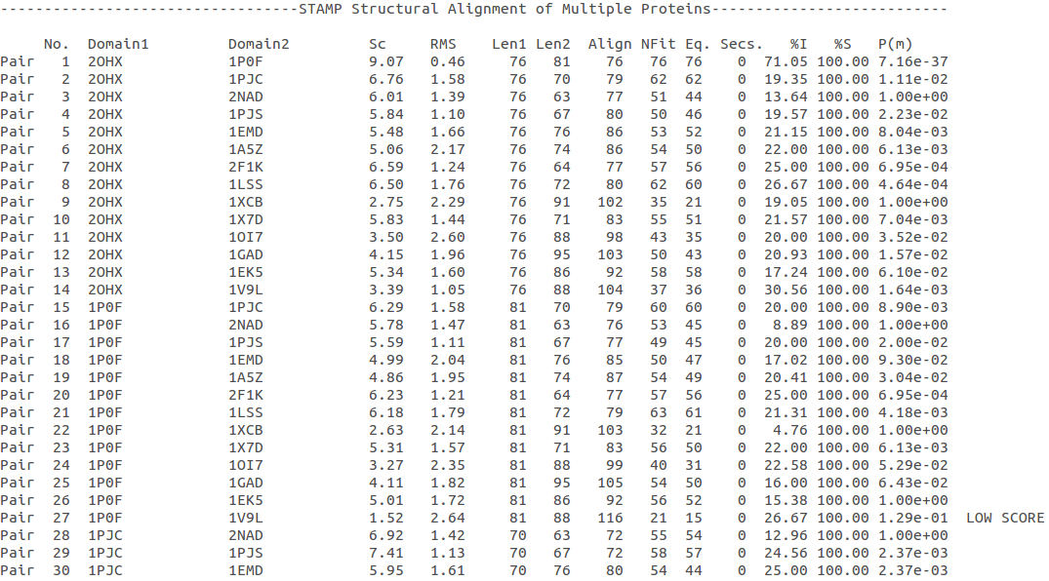
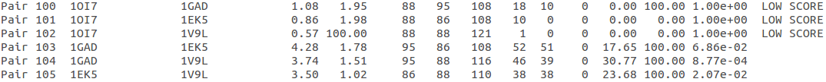
Structure
Superimposition of Rossmann core (βαβαβ + β4)
18/105
RMSD
<2: 78
>2 i <3: 27
Sc
5.5-9.8: 45
2.5-5.5: 39
< 2.5: 21
(….)
Superimposition of 2OHX, 1P0F, 1PJC, 2NAD, 1PJS, 1EMD, 1A5Z, 2F1K, 1LSS, 1XCB, 1X7D, 1OI7, 1GAD, 1EK5, 1V9L

Slide 19
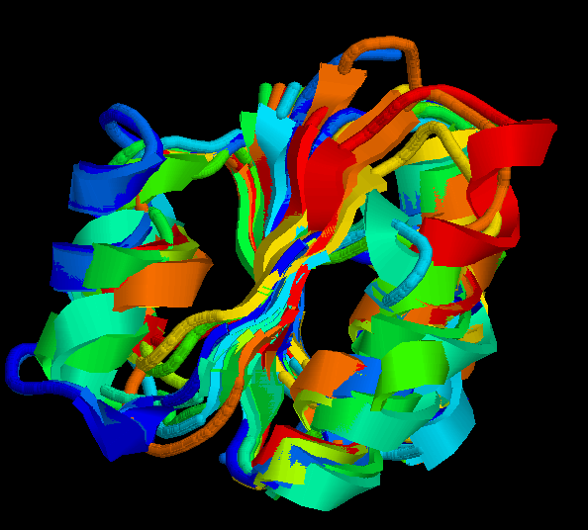
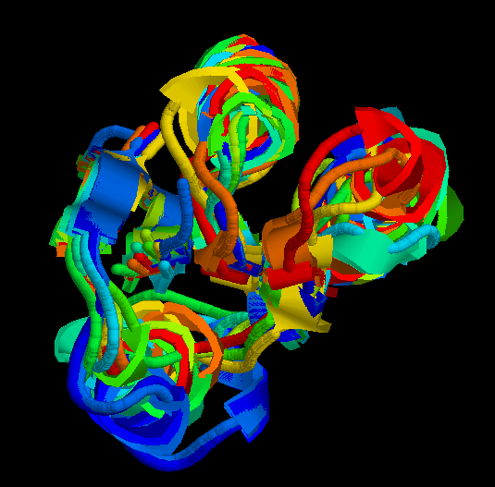
Structure
Superimposition of Rossmann core (βαβαβ + β4)
Minimum structure conserved in most proteins: first motif (βαβαβ) + β4 (70 Aa)
Rasmol display of superimposition of βαβαβ + β4, conserved in most proteins. Not included: 1XCB, 1OI7, 1GAD, 1EK5, 1V9L

Slide 20
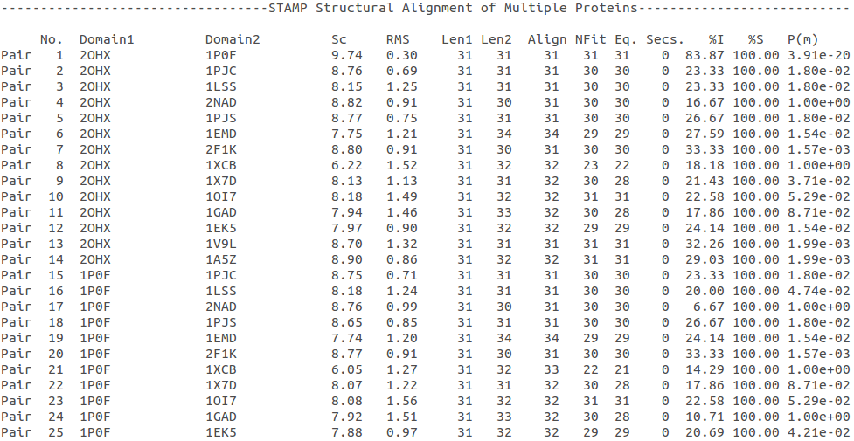
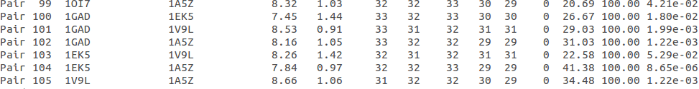
Structure
Superimposition of fingerprint region βαβ
Any LOW SCORE
RMSD
<2: 105
>2 i <3: 0
Sc
5.5-9.8: 105
2.5-5.5: 0
< 2.5: 0
(….)
Superimposition of 2OHX, 1P0F, 1PJC, 2NAD, 1PJS, 1EMD, 1A5Z, 2F1K, 1LSS, 1XCB, 1X7D, 1OI7, 1GAD, 1EK5, 1V9L

Slide 21
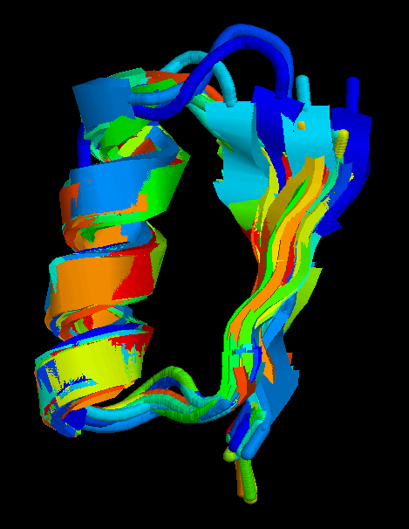
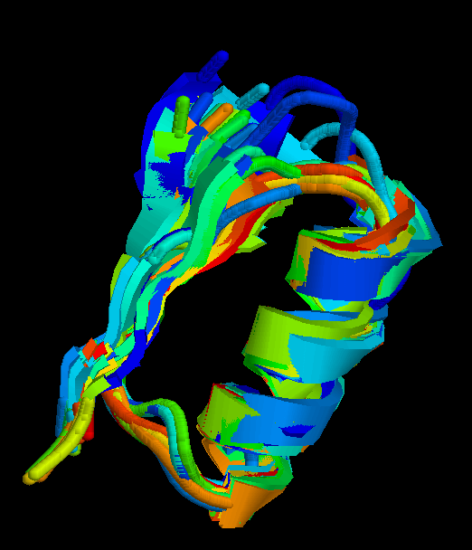
Structure
Superimposition of fingerprint region βαβ
Structure is conserved in all proteins
Superimposition of 2OHX, 1P0F, 1PJC, 2NAD, 1PJS, 1EMD, 1A5Z, 2F1K, 1LSS, 1XCB, 1X7D, 1OI7, 1GAD, 1EK5, 1V9L

Slide 22
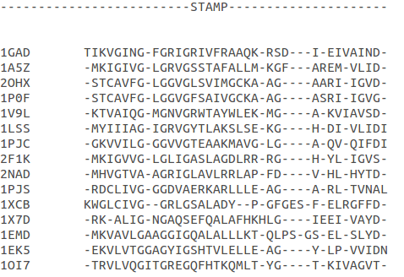



Structure
Structural aligment of fingerprint region βαβ
30-35 amino-acids:
Glycine-rich phosphate-binding sequence: GX₁₋₂GXXG
Hydrophobic core
Negatively charged residue at C-t of the β2 (NAD, not NADP)
Positively charged residue at the N-terminus of β1
Glycine residues
Hydrophobic residues
Negatively charged residues
Positively charged residues

Slide 23
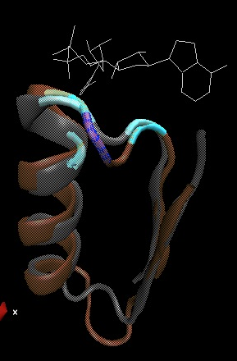
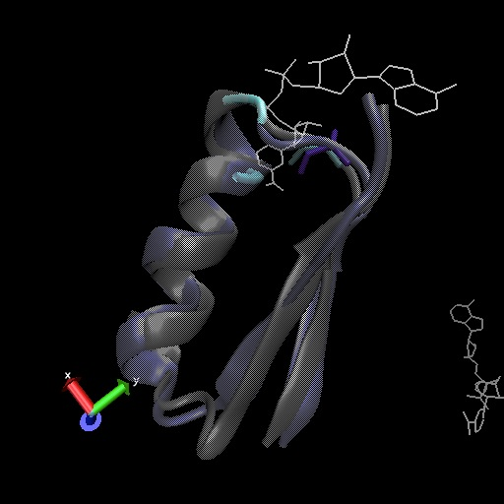
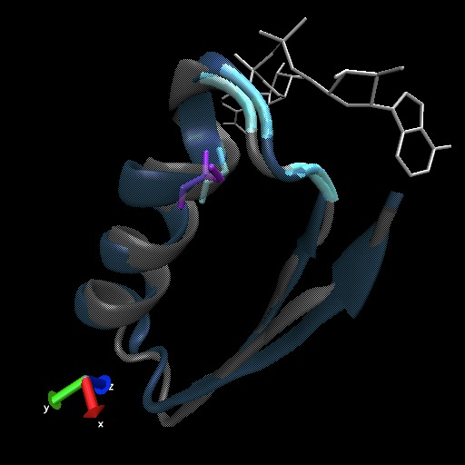
Structure
Superimposition of fingerprint region βαβ
Different glycine-rich phosphate-binding sequence: GX₁₋₂GXXG
Ornithine cyclodeaminase (1X7D)
Malate dehydrogenase (1EMD)
Formate dehydrogenase (2NAD)
2OHX
1EMD
2OHX
2NAD
2OHX
1X7D

Slide 24
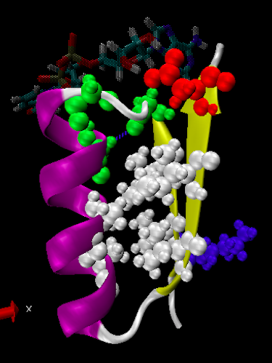
Function
GX₁₋₂GXXG
Hydrophobic core
Negative charged residue
Positively charged residue
Fingerprint region
conserved
characteristics
Which interactions are important in NAD binding?
Why are they conserved?
Which is their function?
L-alanine dehydrogenase
(NAD)
Alcohol dehydrogenase
(NADP)
L-alanine dehydrogenase

Slide 25
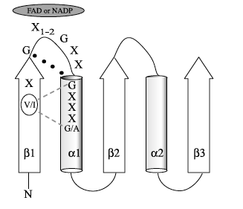
Function
G X₁-₂ G X X G
Glycine-rich phosphate-binding loop
There is a Cα –H· · ·O hydrogen bonds between the third and the first glycyl residue
In addition, Rossmann folds that bind NAD(P) also typically contain GXXXG or GXXXA motifs, both forming Van der Waals interactions with a valine or isoleucine residue located either seven or eight residues further back along the polypeptide chain.
  The first strictly conserved glycine allows for a tight turn of the main chain from the β -strand into the loop, which is important for positioning the second glycine.
  The second glycine allows for close contact to NAD(P) pyrophosphate
  The third glycine is important for the close packing of the helix with the β -strand.
NAD
Notes:
On esta: Glycine-rich phosphate-binding loop connects the C-terminus of the first B-sheet with N-terminus of the first a-helix.
Typically, this loop contains three conserved glycine residues arranged in patterns such as GXGXXG or GXXGXXG. There are many types of the pyrophosphate-binding loop: GXXXGXG, or GXXXXXG and GXXXXXXXG. Sometimes Ala substitutes for the last Gly, and, in one case, dihydropyrimidine dehydrogenase, Ser substitutes for the last Gly.
In many structures there is a formation of Ca –H· · ·O hydrogen bonds between the third and the first glycyl residue of the motif that appears to enhance the stability of the ligand-binding loop connecting a -helix 1 with b -strand 1. The backbone amides of this loop form hydrogen bonds with the pyrophosphate moiety of the nucleotide cofactor, explaining why stability of the loop is important.
In addition to this sequence motif, Rossmann folds that bind FAD and NAD(P) also typically contain either GXXXG or GXXXA motifs, where the first glycyl residue of these motifs and the third glycyl residue of the GX1–2 GXXG motif are the same residue. Therefore, combine both the GX1–2 GXXG and GXXXG/A motifs into an extended motif, V/IXGX1–2 GXXGXXXG/A
This motif stabilizes the interaction of this b -strand 1 and a –hélix 1:
The first glycyl residue of either the GXXXG or GXXXA motif contacts the carbonyl oxygen atom from the first or the third glycyl residue of the GX1–2 GXXG motif (located five or six positions further back along the polypeptide chain) consistent with the formation of a Ca –H· · ·O hydrogen bond.
In addition, both the glycyl and alanyl residues of the GXXXG or GXXXA motifs form van der Waals interactions with either a valine or isoleucine residue located either seven or eight residues further back along the polypeptide chain from the first glycine of the GXXXG or GXXXA motifs.
In addition to this sequence motif, Rossmann folds that bind FAD and NAD(P) also typically contain either GXXXG or GXXXA motifs, where the first glycyl residue of these motifs and the third glycyl residue of the GX1–2 GXXG motif are the same residue. Therefore, combine both the GX1–2 GXXG and GXXXG/A motifs into an extended motif, V/IXGX1–2 GXXGXXXG/A
This motif stabilizes the interaction of this b -strand 1 and a –hélix 1:
The first glycyl residue of either the GXXXG or GXXXA motif contacts the carbonyl oxygen atom from the first or the third glycyl residue of the GX1–2 GXXG motif (located five or six positions further back along the polypeptide chain) consistent with the formation of a Ca –H· · ·O hydrogen bond.
In addition, both the glycyl and alanyl residues of the GXXXG or GXXXA motifs form van der Waals interactions with either a valine or isoleucine residue located either seven or eight residues further back along the polypeptide chain from the first glycine of the GXXXG or GXXXA motifs.
Hidrophobic core
The hydrophobic core of the fingerprint region, consisting of six positions typically occupied by small hydrophobic amino acids. These residues are necessary for steric interactions of the secondary structure elements, specifically the packing of the [3- strands against the ahelix].

Slide 26
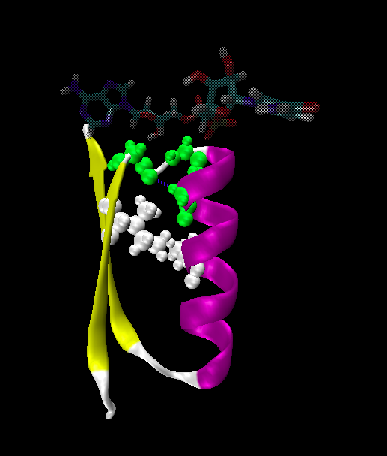
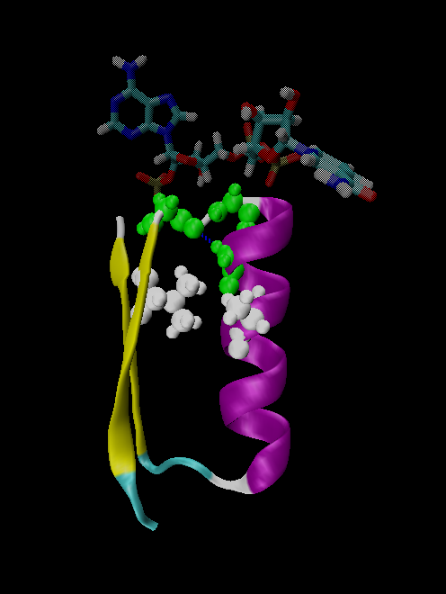
NAD
NADP
Gly 176
Gly 198
Gly 174
Gly 200
Gly 179
Gly 203
Ile 172
Val 196
Ala 183
Ala 207
L-AlaDH
GX₁₋₂GXXGXXXA
ADH8

Slide 27
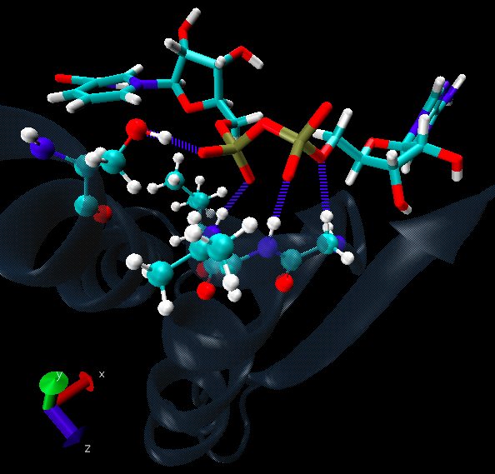
Function
Pyrophosphate Group
  Pyrophosphate group binds to the central region β sheet.
  Some residues form HB to the pyrophosphate group
    The second Glycine of GXGXXG
    Residues in the N-t of αA
Ser 133
Val 178
Gly 176
Val 177
L-alanine dehydrogenase
Notes:
In many structures there is a formation of Ca –H· · ·O hydrogen bonds between the third and the first glycyl residue of the motif that appears to enhance the stability of the ligand-binding loop connecting a -helix 1 with b -strand 1. The backbone amides of this loop form hydrogen bonds with the pyrophosphate moiety of the nucleotide cofactor, explaining why stability of the loop is important.
The amino end of α -helix A makes hydrogen bonds to the pyrophosphate group and thereby positions. The position of the phosphates, either O1N or O2N (negatively charged pyro phosphate-oxygens) lies closest to the aB helix and interacts with the amide hydrogen of the last glycine in the fingerprint region. The glycine involved in this interaction is the most strictly conserved residue within the phosphate binding consensus of the fingerprint región. This interaction between the pyrophosphate-oxygen of NAD(P) and the glycine is typically a long hydrogen bond (from 2.8 to 3).6 A or mediated by water!
The nucleosides on the flanks of NAD bind outside the β strands to opposite sides of the β sheet.

Slide 28
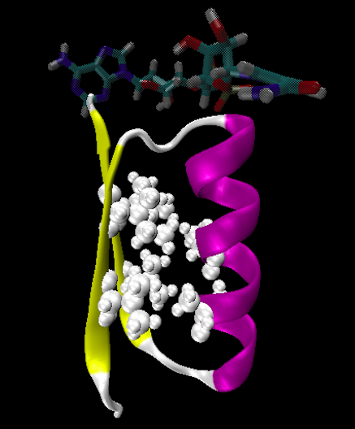
Function
Hydrophobic Core
The hydrophobic core of the fingerprint region, consisting of six positions occupied by small hydrophobic amino acids.
These residues are necessary for the packing of the β strands against the α helix.
NAD
Ile 195
Ile 172
2222
Ala 183
Val 170
Ala 186
Val 183
L-alanine dehydrogenase

Slide 29


Function
Negative Charge
NAD
Conserved aspartate → HB 2’OH adenosine ribose
NADP
Neutral residue → small residue for the additional phosphate group
Asp 197
Gly 222
L-AlaDH
ADH8

Slide 30

Function
Positive Charge
A conserved positively charged residue at the amino terminus of the β1 strand, usually Lys or Arg.
Its role is not fully understood, but it appears to make a stabilizing interaction with the core elements β1 and β4.
NAD
Lys 169
L-alanine dehydrogenase

Slide 31

Function
Conserved water
NAD(P) binding proteins accommodate water molecules, many of these form water-mediated HB
Conserved water molecule: HB between the Gycine-rich loop and pyrophosphate.
This water typically makes 4 HB:
  Two invariant with pyrophosphate and conserved Gly.
  Two variant that involve the 1st or 2nd conserved Gly and a C-terminal residue of β4
L-alanine dehydrogenase
Notes:
NADP- and NAD-binding proteins accommodate about 11 and 9 interfacial (within 3,75A of the protein and dinucleotide) water molecules per dinucleotide-binding site, respectively. Many of these interfacial water molecules form water-mediated hydrogen bonds to both dinucleotide and the protein.
The typical binding sites contains about 9-12 water molecules, and about 30% (29% in NAD and 32% in NADP) of the hydrogen bonds between the protein and the dinucleotide are water mediated.
There is a structurally conserved water molecule that links, through hydrogen bonding, the glycine-rich loop and the dinucleotide pyrophosphate moiety. This water molecule displays a conserved hydrogen-bonding pattern.
The structurally conserved water molecule typically makes four hydrogen bonds (en la meua molecula quadra perfectament!). Two of the four bonds are invariant, these ones involves pyrophosphate and the amine of the last conserved Gly, and two vary according the sequence pattern of the glycine-rich phosphate-binding loop
Almost without exception, the pyrophosphate atom that interacts with the structurally conserved water molecule is O1N in the case of the NAD or NADP-binding proteins.
One sequence-dependent hydrogen bond involves either the first or second conserved Gly in strucutres with the sequence patterns GXGXXG (en este cas en la 2na), GXXGXXG and GXXXXXXXG (I en GXXXGXG en la 1a Gly) (not occur in structures with the sequence pattern GXXXXXG). The second sequence-dependent hydrogen bond involves a C-terminal residue of β4. In structures with the pattern GXGXXG and GXXGXXG, this hydrogen bond usually involves the backbone carbonyl of either a small residue or a hydrophobic residue (i.e., Ala, Cys, Gly, Leu, Phe, Ser, or Val). (en la meua una Ala). However, occasionally it will involve the hydroxyl of Ser or Thr. In structures with the sequence pattern GXXXGXG, the C-terminal residue of β4 usually donates a hydrogen bond via the side chain of an Asn. In structures with the sequence pattern GXXXXXXXG, the C-terminal residue of β4 donates a hydrogen bond via a Ser hydroxyl.
- N-INICIAL DE LA ALFA HELIX?? EL PYROFOSFAT I EL RESIDU GLY ALA 237???

Slide 32


Function
More interactions
Adenosine Group
Leu 248
NAD
Val 238
The adenine binds through an hydrophobic pocket.
Mainly held in place by hydrophobic and Van der Waals interactions.
The adenine can make one or several hydrogen bonds with the protein, some can be mediated by a bridging water molecule
Gly 174
Ser 219
Ile 198
L-alanine dehydrogenase
Notes:
A la proteina de la blanca els dos OH de la ribosa també interaccionen amb LA carrega negativa.
1. Binds through an hydrophobic pocket made up by the side chains along a shallow groove across the top of the turn between β1 and αB.
2. The hydroxyls of adenine make hydrogen bonds to the protein, and is mainly held in place by hydrophobic and van der Waals interactions.
3. Some hydrogen bonds are usually mediated by a bridging water molecule and are not made with conserved residues.
4. In NAD binding proteins the conserved negative charge is responsible for the discrimination between NAD and NADP because the 2’-OH adenosine ribose makes hydrogen bonds with this conserved residue.

Slide 33

Function
NAD
GOL
Nicotinamide Ribose Group
GOL
NADP
Nicotinamide ribose binds to the second motif curving down towards the interior of the sheet between β strands 4, 5, and 6.
One side of the ring interacts with the structural framework of the NAD(P)-binding domain, and the other side faces the substrate binding site.
4
5
6
Alcohol dehydrogenase

Slide 34

Function
NAD
GOL
The nicotinamide is held into place by up to six hydrogen bonds with the protein.
Water molecules are occasionally used as ligands to the cofactor.
NAD
NAD
Val 297
NAD
NAD
Val 266
Met 300
Val 178
NAD
NAD
H₂O
Ala 136
H₂O
L-alanine dehydrogenase

Slide 35

Function
Cofactor orientation
Most NAD molecules adopt an extended shape
Position of the pyrophosphate and adenosine moiety is quite constant
The nicotinamide ring is more variable
Conserved water molecule
Superimposition of 2OHX, 1PJC, 2NAD, 1EMD with cofactor

Slide 36


Function
Cofactor orientation
NAD must be positioned in the active site sufficiently close and in the correct orientation to allow electron transfer.
Residues with aromatic rings are involved in better transferring of the H
NAD binding is stabilized by interactions with protein: VDW and HB (direct or through water)
Phe 93
GOL
NAD
Alcohol dehydrogenase with its substrate

Slide 37


Function
Hydrogen transfer to NAD is stereospecific
There are two different forms of NAD, which differ by a flip of the nicotinamide ring 180º around the glycosidic bond that links it to the ribose.
The concavity that makes the protein and interactions with NAD define two classes:
Class A
Class B
H is transferred to the position above the ring
H is transferred to a position below the ring
L-alanine dehydrogenase
Glyceraldehyde-3-phosphate dehydrogenase

Slide 38




Function
Stereospecificity
Class A
L-alanine dehydrogenase
180º
Class B
Glyceraldehyde-3-phosphate dehydrogenase

Slide 39

Evolution
Glyceraldehyde 3 phosphate dehydrogenase
Protein | Specy
1DSS | Panulirus versicolor (invertebrate)
1NBO | Spinaca oleracea
2B4R | Plasmodium falciparum
1GAD | Escherichia Coli
1U8F | Homo sapiens

Slide 40
Conclusions
NAD-binding proteins show small sequence identity.
The overall topologies of the NAD-binding domain show variations. Not all the 6 strands are essential to NAD- binding.
There is a minimum structure conserved in most proteins: first motif (βαβαβ) and β4. β1 and β4 are located in the center of the NAD-binding domain and are involved in cofactor binding.
The fingerprint region (βαβ) is conserved in all proteins and have several conserved residues important for its function.
These residues are involved in NAD interactions with protein through VDW and HB (direct or through water). There is also a structurally water molecule conserved.
Interactions between NAD and the protein allow the correct orientation of the cofactor and the electron transfer with the substrate. The transfer is stereospecific.
It is difficult to decide if low seguence homology but structural preservation of NAD binding domains is due to:
Convergent evolution from different ancestral genes
Divergent evolution from a common ancestor (remote homologs)

Slide 41
References
Anantharaman V, Koonin EV, Aravind L. Regulatory Potential, Phyletic Distribution and Evolution of Ancient, Intracellular Small-molecule- binding Domains. J. Mol. Biol. (2001) 307, 1271±1292.
Auerbach G, Ostendorp R, Prade L, Korndörfer I, et al. Lactate dehydrogenase from the hyperthermophilic bacterium Thermotoga maritima: the crystal structure at 2.1 Å resolution reveals strategies for intrinsic protein stabilization. Structure 15 June 1998, 6:769–781.
Baker P.J. Analysis of the structure and substrate binding of Phormidium lapideum alanine dehydrogenase. Nature structural biology. July 1998; 5:7.
Bellamacina C.R. The nicotinamide dinucleotide binding motif: a comparison of nucleotide binding proteins. Faseb J. 1996 Sep;10(11):1257-69.
Brandrn CI, Eklund H, et al . Structure of Liver Alcohol Dehydrogenase at 2.9-A Resolution. August 1973. Vol. 70, No. 8, pp. 2439-2442.
Bottoms C, Smith P.E, Tanner J.A. Structurally conserved water molecule in Rossmann dinucleotide-binding domains. Protein Science. 2002. June 4.
Bhuiya M, Sakuraba H, et al. The First Crystal Structure of Hyperthermostable NAD-dependent Glutamate Dehydrogenase from Pyrobaculum islandicum. J. Mol. Biol. (2005) 345, 325–337.
Ghosh S, George S, Roy U. NAD: A master regulator of transcription. Biochimica et Biophysica Acta 1799 (2010) 681–693.
Jessica L. Goodman J.L, Susan Wang S, et al. Ornithine Cyclodeaminase: Structure, Mechanism of Action, and Implications for the μ-Crystallin Famil. American Chemical Society. 2004. August 18.
Kim SY, Hwang KY, et al. Structural Basis for Cold Adaptation: Sequence, biochemical properties, and crystal structure of malate dehydrogenase from a psychrophile aquaspirillium arcticum. J Biol. Chem. 1999, 274:11761-11767.
Legrant P, Dumas R, et al. Biochemical Characterization and Crystal Structure of Synechocystis Arogenate Dehydrogenase Provide Insights into Catalytic Reaction. April 2006. Structure 14, 767–776.
Mark A. Robien MA, Bosch J, Buckner F.S, et al. Crystal Structure of Glyceraldehyde-3-Phosphate Dehydrogenase from Plasmodium falciparum at 2.25 Å Resolution Reveals Intriguing Extra Electron Density in the Active Site. PROTEINS: Structure, Function, and Bioinformatics (2006); 62:570–577.

Slide 42
References
Rosell A, Valencia E, et al. Crystal Structure of the Vertebrate NADP(H)- dependent Alcohol Dehydrogenase (ADH8). J. Mol. Biol. (2003) 330, 75–85.
Rubach J.K, Plapp B.V. Amino Acid Residues in the Nicotinamide Binding Site Contribute to Catalysis by Horse Liver Alcohol Dehydrogenase. Biochemistry 2003, 42, 2907-2915.
Roosild T.P, Miller S, Booth IR, Choe S. A Mechanism of Regulating Transmembrane Potassium Flux through a Ligand-Mediated Conformational Switch. 2002, Cell, Vol. 109, 781–791, June 14.
Rubach J.K, Plapp B.V. Amino Acid Residues in the Nicotinamide Binding Site Contribute to Catalysis by Horse Liver Alcohol Dehydrogenase. Biochemistry 2003, 42, 2907-2915.
Song S, Xu Y, Lin Z, Tsou C. Structure of Active Site Carboxymethylated D-Glyceraldehyde-3-phosphate Dehydrogenase from Palinurus versicolor. J. Mol. Biol. (1999) 287, 719±725.
Stroupe M.E, Leech H.K, Daniel D.S, Warren M.J, Getzoff E.D. CysG structure reveals tetrapyrrole-binding features and novel regulation of siroheme biosynthesis. Nat Struct Biol. 2003 Dec;10(12):1064-73.
Sickmier EA, Brekasis D, Paranawithana D.S, Bonanno J.B, et al. X-Ray Structure of a Rex-Family Repressor/NADH Complex Insights into the Mechanism of Redox Sensing. Structure. January, 2005. Vol. 13, 43–54.
Stockwell G.R, Thornton J.M. Conformational Diversity of Ligands Bound to Proteins. J. Mol. Biol. (2006) 356, 928–944.
Peter Belenky, Katrina L. Bogan and Charles Brenner. NAD metabolism in health and disease. RENDS in Biochemical Sciences Vol.32 No.1.
Tomita T, Fushinobu S, Kuzuyama T, Nishiyama M. Crystal structure of NAD-dependent malate dehydrogenase complexed with NADP(H). Biochemical and Biophysical Research Communications 334 (2005) 613–618.

Slide 43
References
Uchikoba H, Fushinobu S, Wakagi T, Konno M, Taguchi H, Matsuzawa H .Crystal Structure of Non-Allosteric L-Lactate Dehydrogenase From Lactobacillus pentosus at 2.3 Å Resolution: Specific Interactions at Subunit Interfaces. PROTEINS: Structure, Function, and Genetics. 2002;46:206–214.
Michel G, Roszak W.A, Sauvé V, Maclean J, Matte A, Coggins J.R, Cygler M, Adrian. Structures of Shikimate Dehydrogenase AroE and Its Paralog YdiB: A common structural framework for different activities. J. Biol. Chem. 2003, 278:19463-19472.
Stroupe M.E, Leech H.K, Daniel D.S, Warren M.J, Getzoff E.D. CysG structure reveals tetrapyrrole-binding features and novel regulation of siroheme biosynthesis. Nat Struct Biol. 2003 Dec;10(12):1064-73.
Thoden J.B, Wohlers T.M, Fridovich-Keil J.L, Holden H.N. Crystallographic Evidence for Tyr 157 Functioning as the Active Site Base in Human UDP-Galactose 4-Epimerase. Biochemistry 2000, 39, 5691-5701.
Lesk A.M. NAD-binding domains of dehydrogenases. University of Cambridge Clinical School, Cambridge; UK. Current Opinion in Structural Biology, 5: 775: 783.
Kleiger G, Eisenberg D. GXXXG and GXXXA Motifs Stabilize FAD and NAD(P)-binding Rossmann Folds Through C – H· · ·O Hydrogen Bonds and van der Waals Interactions. J. Mol. Biol. (2002) 323, 69–76.

Slide 44
Questions
The classical NAD(P)-Binding fold domain is:
Greek key B-sandwich
Rossmann fold
a and b
4 helix bundle
all answers are correct
2. Talking about the two Rossmann folds motifs that form a NAD(P)-Binding site domain:
In the classical one, the two motifs form an open parallel six stranded B-sheet with alpha helices located on both side of the sheet.
B-strands and a-helixes form a characteristic TIM Barrel in these motifs
NAD is bounded in the topological switch point
B-strands are antiparallel
1, 2, 3
1, 3
2, 4
4
1, 2, 3, 4

Slide 45
3. NAD(P)-Binding enzymes
Are involved in different redox reactions
Require NAD or NADP as a cofactor to transfer electrons
The cofactor and the substrate must be nearly located to allow the electron transfer.
Bind their substrates and NAD(P) in different domains
a) 1, 2, 3
b) 1, 3
c) 2, 4
d) 4
e) 1, 2, 3, 4
4. Hydrogen transfer to NAD(P):
Is stereospecific
There are two different classes of NAD: A and B
The two forms of NAD differ by a flip of the nicotinamide ring, 180º around the glycosilic bond that links it to the ribose
What defines the two different classes is the concavity that makes the protein and the interactions with NAD.
all the answers are correct
5. The fingerprint region of the Rossmann fold…
It is a region of approximately 35 residues
It has got some conserved residues which are important for its function
a and b are correct
Does not have any conserved residue involved in it is function.
Is the most variable region in the Rossmann fold

Slide 46
6. The fingerprint region of the Rossmann fold is characterized by…
A glycine rich phosphate binding sequence
An hydrophobic core of six residues
A negatively charged residue located in the C-terminus of the first B-strand
A region of 20 consecutive leucine residues
1, 2, 3
1, 3
2, 4
4
1, 2, 3, 4
7. As far as NAD(P) interaction is concerned…
NAD(P) molecules adopt and extended shape similar to a boomerang
NAD(P) binding is stabilized by interaction with the protein which involves hydrogen bonds and VDW contacts.
A and b are correct
NAD(P) pyrophosphate group does not have any interaction with the protein
All the answers are correct
8. NAD and NADP….
Are oxidizing agents that can be reduced to NADH and NADPH, respectively.
Are used as a cofactor to shuttle electrons between proteins
A and b are correct
NADP has an additional phosphate group in 2’ of the adenosine ribose
All the answers are correct

Slide 47
9. As far as NAD(P) interaction is concerned…
Glycine residues are important to adopt a good conformation that allows a correct contact with the NAD(P) cofactor
Hydrogen bonds are involved in the interaction between NAD(P) and the protein
The pyrophosphate group interacts with an structurally conserve water molecule
Water molecules are not involved in forming hydrogen bonds
1, 2, 3
1, 3
2, 4
4
1, 2, 3, 4
10. As far as interaction between NAD(P) is concerned…
Residues with aromatic rings are involved in the hydrogen transfer
A negatively charged residue at the C-terminus end of the second b-strand is important to discriminate between NAD and NADP
a and b are correct
There is not any difference between binding NAD or NADP cofactors.
All the answers are correct

Slide 48


Slide 49

Glyceraldehyde 3 phosphate dehydrogenase

Slide 50

Glyceraldehyde 3 phosphate dehydrogenase

